Slide 2
16
Human Development

Slide 3
16

Slide 4
Essential Question
What intellectual, emotional, and social developments occur during each stage of the life span?

Slide 5
16.1
The Beginning of Life

Slide 6
Learning Outcomes
After studying this lesson, you will be able to
describe the male and female reproductive systems.
explain what the menstrual cycle is.
explain what causes fertilization to take place.
(continued)

Slide 7
Learning Outcomes
After studying this lesson, you will be able to
summarize the changes in a pregnant woman’s body.
describe what happens to the developing child in the three stages of fetal development.

Slide 8
Human Reproductive System
The human reproductive system- Body system that consists of a group of organs working together to make the creation of new life possible- works to create new life
Does not begin to work at birth, but starts at puberty
Different in males and females
(continued)

Slide 9
Human Reproductive System

Slide 10
Human Reproductive System
Male reproductive system
Produces and transports sperm (male sex cells) and the hormone testosterone
Reproductive organs grow and mature as males enter puberty
The seminal vesicles and prostate secrete semen to protect and nurture sperm when it leaves the body
(continued)

Slide 11
Human Reproductive System
(continued)
©Body Scientific International

Slide 12
Human Reproductive System
Female reproductive system
Produces female sex cells (eggs, or ova) and the hormone estrogen
Female sex organs include the ovaries, fallopian tubes, uterus, and vagina
A baby develops within the uterus and is delivered through the vagina
(continued)

Slide 13
Human Reproductive System
(continued)
©Body Scientific International

Slide 14
Human Reproductive System
Starting during puberty, females have a menstrual cycle
The uterus discharges some blood and tissues, called menstruation- Discharge of some blood and tissues from the uterus
The uterus receives an egg in preparation for possible pregnancy during ovulation- Release of an egg from one of the follicles into the uterus
If the uterus does not accept a fertilized egg, menstruation begins again

Slide 15
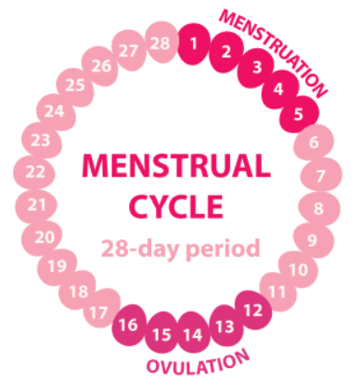
Human Reproductive System

Slide 16
Human Sexual Reproduction
For a pregnancy to occur, a male’s sperm must enter a female’s vagina
In sexual intercourse, one sperm and one mature egg combine, called fertilization- Process by which the sperm and egg combine to create a zygote
An egg that has been fertilized by a sperm is called a zygote, which marks the beginning of a pregnancy
(continued)

Slide 17
Human Sexual Reproduction

Slide 18
Health Alert!
The first sign of pregnancy is usually a missed menstrual period
Narong Jongsirikul/Shutterstock.com

Slide 19
Human Sexual Reproduction
A pregnant woman should regularly visit an obstetrician/gynecologist (OB/GYN) - Type of doctor who specializes in pregnancy, labor, and delivery,
who can help
ensure that mother and developing baby remain healthy
look for signs of possible difficulties
Rawpixel.com/Shutterstock.com

Slide 20
Prenatal Development
Most babies are born after 36 to 40 weeks of prenatal development- Period of growth that occurs from conception to birth
Germinal stage
Embryo implants in the lining of uterus
Embryonic stage
Placenta and umbilical cord develop
Fetal stage
Embryo is now called a fetus- Term that describes a developing baby during the fetal stage of prenatal development
Zygote divides into mass of cells called an embryo- Term that describes a developing baby during the embryonic stage of prenatal development
Development of organs, bones, and muscles
Major organs begin to form and heartbeat begins

Slide 21
Prenatal Development

Slide 22
Lesson Review
The discharge of some blood and tissues from the uterus is called _____.
menstruation
What two things combine in fertilization?
one sperm and one mature egg
True or false? The embryonic stage includes the formation of the embryo.
false

Slide 23
16.2
Child Development

Slide 24
Learning Outcomes
After studying this lesson, you will be able to
identify the different areas of development in the human life cycle.
describe the factors that influence development.
(continued)

Slide 25
Learning Outcomes
After studying this lesson, you will be able to
summarize the different ways a child develops during early childhood.
explain the different ways a child develops during middle childhood.

Slide 26
The Human Life Cycle
Sequence of developmental stages a person experiences from birth through adulthood is the human life cycle
Includes early childhood, middle childhood, adolescence, and adulthood
Each stage includes milestones- Important events that occur in each of the developmental stages of the human life cycle
(continued)

Slide 27
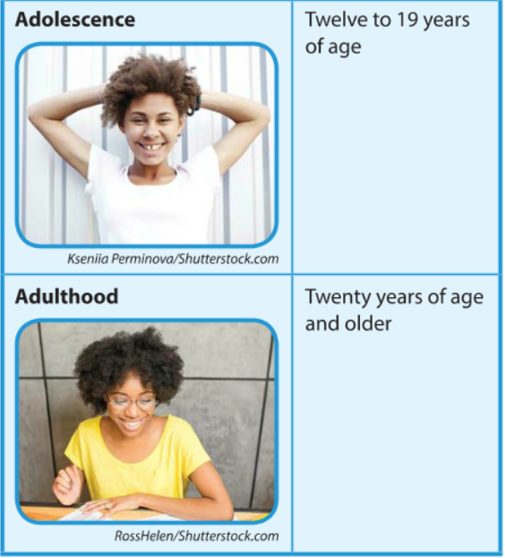
The Human Life Cycle

Slide 28
The Human Life Cycle
A person’s life span is the actual number of years a person lives
Life expectancy- Estimate of how long a person in a particular society is likely to live

Slide 29
The Human Life Cycle

Slide 30
Types of Human Development
Physical development
Intellectual development
Emotional development
Social development
Growth of body parts
Other development builds on the basis of this
How a person processes information and thinks
Ability to form an identity and personality
Includes having self-esteem
and acting independently
The ability to interact with others in acceptable ways
Much of the foundation for this is laid in childhood
Includes learning to speak

Slide 31
Influences on Development
Internal influences on development
Nutrition and physical activity
Lifestyle decisions
Social relationships
External influences on development
Genetic makeup
Quality of healthcare and environment

Slide 32
Early Childhood
Infancy through preschool years
Early childhood - Period of time from infancy through the preschool years
Infant
Birth to 1 year
Toddler
1–3 years
Preschooler
3–5 years
FamVeld/Shutterstock.com; Monkey Business Images/Shutterstock.com; Olesia Bilkei/Shutterstock.com

Slide 33
Early Childhood
During the early childhood years,
infants rely entirely on caregivers
toddler’s achieve many milestones, including walking, talking, and throwing temper tantrums- Toddler’s episode of emotional upset that often includes yelling, crying, hitting, kicking, or even biting
preschoolers rapidly develop language skills, gross-motor skills- Movements that use the large muscles of the body , fine-motor skills- Movements that use the small muscles of the body, and social relationships

Slide 34
Middle Childhood
Between 5 and 12 years of age
Middle childhood- Period of time when children are between 5 and 12 years of age; also called the school-age years
Expanding social network and self-esteem
Steady growth of height and weight and new involvement in organized sports
Better language skills and problem-solving

Slide 35
Lesson Review
Ability to form a personal identity and self-esteem is _____ development.
emotional
What kind of influence on a person’s development is his or her genetic makeup?
external influence
(continued)

Slide 36
Lesson Review
Which stage of early childhood development includes temper tantrums?
the toddler years
The developmental stage that includes children beginning to go to school is _____.
middle childhood

Slide 37
16.3
Adolescence and Puberty

Slide 38
Learning Outcomes
After studying this lesson, you will be able to
describe the physical changes that occur in males during puberty.
explain the physical changes that occur in females during puberty.
(continued)

Slide 39
Learning Outcomes
After studying this lesson, you will be able to
summarize the intellectual, emotional, and social growth and development that occurs during adolescence.
identify common health and wellness issues that affect adolescents.

Slide 40
Adolescence
Between 12 and 19 years of age
The trademark of adolescence- Period of development between 12 and 19 years of age- is physical changes, including puberty- Stage of life when the body reaches sexual maturity
Males and females complete most of their height and weight growth
Males start to produce testosterone- Hormone that triggers growth and development of the male sex organs ,and females start to produce estrogen- Hormone that triggers growth and development of the female sex organs
(continued)

Slide 41
Adolescence

Slide 42
Infographic Discussion
Are the changes from puberty social, physical, emotional, or intellectual development?

Slide 43
Male Reproductive System Care

Slide 44
Female Reproductive System Care

Slide 45
Adolescence
Intellectual development
Think through complex and challenging problems
Understand different points of view
May fail to predict the consequences of their actions
(continued)

Slide 46
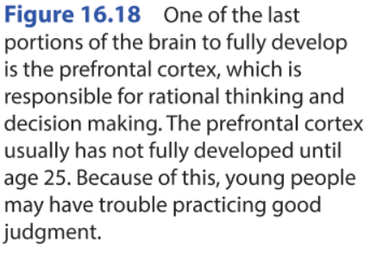
Adolescence

Slide 47
Adolescence
Adolescents establish emotional and social independence
New school activities and friends
Distance from parents can cause conflict
Increasing importance of fitting in with new friends, dating partners, and peers
Developed sense of personal identity

Slide 48
Think About It…
Peers offer independence and support, but can also be a negative influence.
What unhealthy behaviors might adolescents participate in to be accepted by their peers?

Slide 49
Health and Wellness Issues
In response to issues common for their age group, adolescents may need to
stand up against a bully, and not be a bystander
reject influences for unhealthy behavior
make difficult decisions regarding teen pregnancy and teen parenthood

Slide 50
Health and Wellness Issues

Slide 51
Skills Check
Healthy decision-making process
Identify the issue or problem
Identify a possible response
Explore any alternative responses
Analyze the costs and benefits of each option
Select the best option for your health

Slide 52
Lesson Review
The period of time during which sexual organs mature is _____.
puberty
Which hormone do males begin to produce in puberty?
testosterone
(continued)

Slide 53
Lesson Review
True or false? Adolescents typically seek their peers’ approval and try to fit in.
true
What is the name of a person who sees or hears about bullying, but does not stand up for the person being bullied?
bystander

Slide 54
16.4
Adulthood and Aging

Slide 55
Learning Outcomes
After studying this lesson, you will be able to
identify and describe the stages of adulthood.
describe how people can adapt to the changes that occur during aging.
(continued)

Slide 56
Learning Outcomes
After studying this lesson, you will be able to
summarize types of care people may need as they approach the end of life.
explain the stages of grief and how people can cope with grief and loss.

Slide 57
The Mature Adult
At 20 years of age, people
can vote without parent permission
have mature reproductive systems
can plan ahead to make informed decisions
can communicate emotions and maintain healthy relationships

Slide 58
Stages of Adulthood
Young adulthood- Stage of human development that occurs from 20 to 40 years of age
40–65
65+
20–40
Middle adulthood- Stage of human development that occurs from 40 to 65 years of age
Older adulthood- Stage of human development that begins at 65 years of age
AlenD/Shutterstock.com; Monkey Business Images/Shutterstock.com; AshTproductions/Shutterstock.com

Slide 59
Stages of Adulthood

Slide 60
Young Adulthood
Between 20 and 40 years of age
Young adults possess their greatest
strength
endurance
cognitive function
sensory organ performance
reflexes
(continued)

Slide 61
Young Adulthood
Milestones of young adulthood may include
getting a job and enjoying an income
living independently
getting married or having children
Accompanies many financial responsibilities

Slide 62
Young Adulthood

Slide 63
Health Alert!
Not all young adults develop at the same rate. A young adult can
be married, single, or divorced
have children or not have children
live alone, with parents, with roommates, or with a romantic partner
pio3/Shutterstock.com

Slide 64
Middle Adulthood
Between 40 and 65 years of age
Middle-aged adults tend to be fairly healthy and remain active
Physical strength, coordination, and endurance go down over time
Thinking skills and memory remain intact
Some loss of hearing and vision occurs
(continued)

Slide 65
Middle Adulthood
Stresses of middle-aged adults include
meeting financial and emotional needs of adolescent or adult children
increased responsibilities at work
the need to care for their children and aging parents at the same time, called the sandwich generation- Adults who care for their parents as well as their own children

Slide 66
Older Adulthood
65 years of age or older
Changes associated with aging
Retirement and new hobbies, but also lower income
Reduced physical activity to lower impact on joints and bones
May need help driving, dressing, eating, or using the restroom
Relationships with adult children or grandchildren
Loss of mobility and need for wheelchairs, canes, and ramps
Hearing aids or bifocals to improve hearing and vision

Slide 67
Older Adulthood

Slide 68
Older Adulthood

Slide 69
The End of Life
The human life cycle ends in death
Can occur during any stage of life cycle
Hospice care- Type of care given to people who are dying that provides comfort and support to them and their families
Grief is a complex emotional sense of loss and sadness that often accompanies the end of the human life cycle

Slide 70
Lesson Review
True or false? The typical young adult is married, has children, and owns his or her own house.
false
Which stage of adulthood includes gradually decreasing physical strength?
middle adulthood
(continued)

Slide 71
Lesson Review
What technology is available for aging adults with hearing or vision loss?
hearing aids and bifocals
Care that provides comfort to a person who is dying is _____ care.
hospice

