Slide 2
15
Understanding Violent Behavior

Slide 3

15

Slide 4
Essential Question
How might violence or abuse impact a person’s health and wellness?

Slide 5
15.1
Bullying and Cyberbullying

Slide 6
Learning Outcomes
After studying this lesson, you will be able to
discuss what violent behavior is.
contrast bullying, cyberbullying, harassment, and hazing.
describe the consequences of bullying.
(continued)

Slide 7
Learning Outcomes
After studying this lesson, you will be able to
evaluate strategies for responding to bullying.
identify the consequences of cyberbullying.
(continued)

Slide 8
Learning Outcomes
After studying this lesson, you will be able to
explain ways of responding to cyberbullying.
list strategies for bullying prevention.

Slide 9
Violent Behavior
The intentional use of words or actions that cause or threaten to cause injury to someone or something is violent behavior
  Can cause physical or psychological injuries, or both
  Many risk factors can lead to violence, but it is always a personal choice

Slide 10
Risk Factors for Violent Behavior
Individual risk factors
Uncontrolled behavior
Family risk factors
Too harsh, too lenient, or inconsistent discipline
Peer and social risk factors
Peer rejection
Little interest or involvement in school
Discrimination and prejudice
Physical or mental illness
Parental misuse of illegal substances
Peer pressure
Poor academic performance
Involvement in gangs
Community risk factors
Lack of economic opportunities
Poverty
Lack of social services
High crime and unemployment rates
Exposure to violence and abuse
Access to weapons

Slide 11
Bullying
Repeated aggressive behavior toward someone that causes the person injury or discomfort is bullying
  An example of peer abuse- Violent mistreatment of one peer by another
  Type of bullying that targets a particular part of a person’s identity, such as race, religion, gender, or sexual orientation is called harassment
  Also includes hazing- Use of pressure by a group to make someone do something embarrassing or even dangerous to be accepted by a group
(continued)

Slide 12
Bullying
Physical bullying
Emotional bullying
Hitting or punching
Pushing or shoving
Kicking
Biting
Choking
Physical intimidation
Teasing or mocking
Gossiping
Name-calling
Threatening
Excluding
Embarrassing
Stealing
Bullying can be emotional or physical
Bullying is always the fault of the bully, not the victim
(continued)

Slide 13
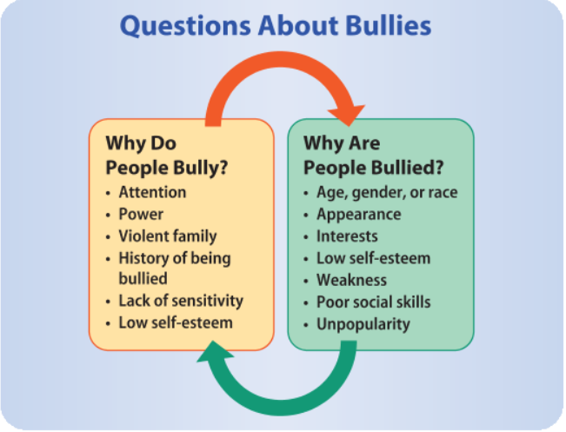
Bullying

Slide 14
Bullying
Young people who are bullied may
Feel afraid to go to school
Have trouble concentrating on homework
Stop hanging out with friends
Quit playing a sport or other activity
Feel angry, sad, lonely, or depressed
Want to hurt someone else or themselves
Feel helpless to stop the bullying

Slide 15
Skills Check(video)
Responding to bullying
Do not participate in the bullying or be a passive bystander
Ask how you can help the victim
Stand up for yourself and tell the bully to stop
Tell an adult about the bullying
Avoid bullying back by hitting or yelling at the bully

Slide 16
Cyberbullying
Forms of bullying that uses electronic means is called cyberbullying
  News can spread far and quickly
  Bullies can remain anonymous online
  Can involve embarrassing, harassing, or threatening through texts, posts on social media, or e-mail
(continued)

Slide 17
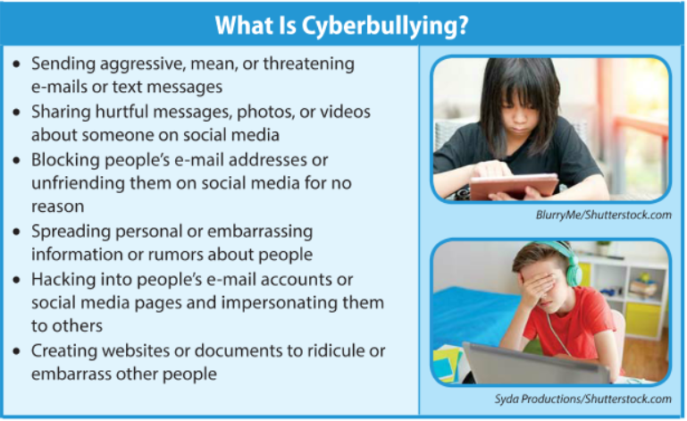
Cyberbullying

Slide 18
Cyberbullying
Cyberbullying has serious consequences
Loneliness and isolation
Low self-esteem
Lower grades
Aggressive actions
Withdrawal from friends and social activities
Changes in sleep, appetite, and behavior
Anxiety before, during, or after using electronics
Avoidance of electronic devices
Suicidal thoughts and behaviors
Anxiety and depression
(continued)

Slide 19
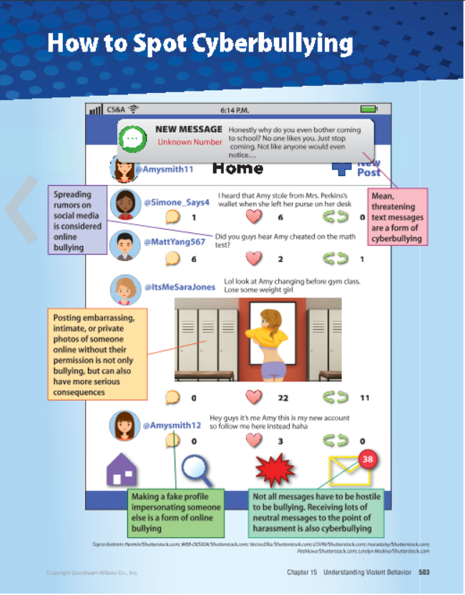
Infographic Discussion
What forms of cyberbullying have you seen?
What did you do to stop it?

Slide 20
Cyberbullying
How to respond to cyberbullying
  Do not participate in cyberbullying
  Block a cyberbully’s ability to contact you
  Do not respond to the bully’s messages
  Save or screenshot the bully’s texts or messages as evidence
  Tell a trusted adult

Slide 21
Skills Check
Strategies for preventing bullying
Build your confidence and self-esteem
Understand the signs of bullying behavior
Appreciate the diversity among your peers
Avoid bullies when possible and use the buddy system
Do not send or post anything that you would not share
Never share passwords to your computer, phone, or social media
Tell an adult who can address the situation before it gets worse

Slide 22
Lesson Review
True or false? Violent behavior always results in physical injuries.
  false
Bullying that targets a person’s race, religion, or sexual orientation is _____.
  harassment
_____ is bullying which occurs online.
  Cyberbullying
(continued)

Slide 23
Lesson Review
Kyle starts receiving hurtful texts and comments on social media from a few of his classmates. What can Kyle do?
  Answers may include: do not respond to the messages, block these peers from his phone and social media accounts, screenshot the messages as evidence, and talk to a trusted adult

Slide 24
15.2
Abuse and Neglect

Slide 25
Learning Outcomes
After studying this lesson, you will be able to
identify the types of abuse.
explain what domestic violence is.
summarize the effects of child abuse and the results of reporting it.
(continued)

Slide 26
Learning Outcomes
After studying this lesson, you will be able to
list forms of sibling abuse and elder abuse.
discuss the cycle of abuse and ways of responding to abuse.
identify strategies for preventing abuse.

Slide 27
Types of Abuse
The consistent, violent mistreatment of a person is abuse
Physical abuse
Any act that causes physical harm to a person; may involve hitting, kicking, choking, slapping, or burning
Emotional abuse
Sexual abuse
Any sexual activity to which one person does not or cannot consent
Attitudes or controlling behaviors that harm a person’s mental health; also called verbal, mental, or psychological abuse
Can include sexual harassment

Slide 28
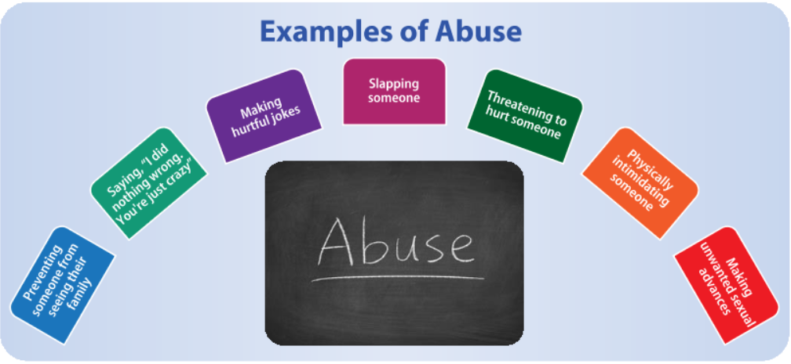
Abuse

Slide 29
Domestic Violence
Abuse that involves couples who are married or in a romantic relationship is domestic violence
  A person tries to control, dominate, threaten, or hurt his or her partner
  Can occur in person or electronically and between current or former partners
  Victims may feel fear, anxiety, and shame

Slide 30
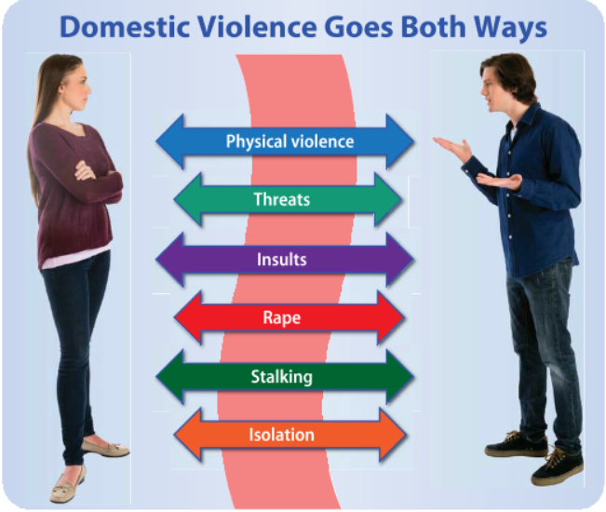
Domestic Violence

Slide 31
Child Abuse
Any act an adult commits that causes harm or threatens to cause harm to a child is child abuse
  Can be emotional abuse, child sexual abuse, or neglect-Type of child abuse in which a child’s basic physical, emotional, medical, or educational needs are not met by parents or guardians
  Can negatively impact a child’s physical, mental and emotional, and social health
(continued)

Slide 32
Child Abuse
Consequences of child abuse
Physical health
Severe bruises, burns, or broken bones
Mental health
Depression, anxiety, or PTSD
Social health
Inability to maintain healthy relationships
Trouble understanding love, trust, and support
Brain damage and poor development
Increased risk of smoking, drinking, or doing drugs
Eating disorders
Learning, attention, and memory problems
Broken sense of
well-being and self-esteem
(continued)

Slide 33
Child Abuse
Knowing the signs of child abuse and neglect can help people know when to report suspicious behavior to authorities
  State hotlines and organizations are available 24/7 for help
  If children are in abusive situations, they may go into foster care
(continued)

Slide 34
Child Abuse
Signs of abuse
  Physical: broken bones or severe bruises
  Sexual: pelvic bruises or torn clothing
  Emotional: withdrawn attitude, anxiety, difficulty sleeping, or aggressive behavior
  Neglect: underweight, poor physical development, and lack of cleanliness

Slide 35
Sibling Abuse
Violent mistreatment of one sibling by another is sibling abuse
  Can be physical, emotional, or sexual
Some sibling rivalry or conflict is normal, but sibling abuse is not
  Part of an ongoing pattern
  Typically one-sided and aims to dominate

Slide 36
Elder Abuse
Mistreatment of older adults in their homes, nursing homes, or other living situations is elder abuse
Inappropriate use of medications
Ignoring calls for help
Sexual abuse
Theft of money or property
Failure to provide food, water, or basic hygiene

Slide 37
Health Alert!
Abuse often occurs in a pattern and the only way to stop it is to break the cycle
Calm
Abuser acts like abuse never happened and may give gifts
Tension building
Abuser grows angry and victim is “walking on eggshells”
Incident
Abuse (of any type) occurs
Reconciliation
Abuser apologizes, blames victim, or denies abuse occurred

Slide 38
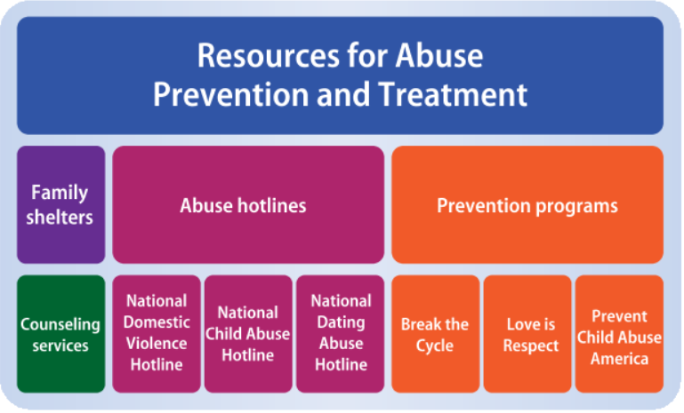
Strategies for Responding to Abuse

Slide 39
Strategies for Responding to Abuse
Immediate responses should address the victim’s injuries and report the abuse
Break the cycle of abuse
Identify the situation as abuse
Do not try to fix or change the abuser
Leave or help someone leave the situation
Seek professional help or intervention

Slide 40
Think About It…
Look up resources in your community (or nationally) for abuse.
What programs help prevent abuse?
What abuse hotlines can victims call?
Where can victims of violence go for treatment or shelter?

Slide 41
Skills Check
Strategies for preventing abuse
Learn about abusive behavior and educate others so you can all recognize and avoid abuse
If you are a victim of abuse, seek help processing your experience in a healthy way
Leave any relationship that shows signs of becoming abusive

Slide 42
Lesson Review
Any sexual activity to which one person does not or cannot consent is _____.
  sexual abuse
What is the term for abuse involving a current or former romantic partner?
  domestic violence
(continued)

Slide 43
Lesson Review
What type of child abuse is neglect?
  when an adult fails to meet a child’s basic needs
What is the difference between sibling rivalry and sibling abuse?
  sibling abuse is part of an ongoing pattern, is typically one-sided, and aims at dominating the victim
(continued)

Slide 44
Lesson Review
In the cycle of abuse, what typically occurs after an incident of abuse?
  reconciliation, in which the abuser apologizes, blames the victim, or denies that the abuse occurred
True or false? At times, abusive behavior in a relationship can be excused.
  false

Slide 45
15.3
Other Types of Violence

Slide 46
Learning Outcomes
After studying this lesson, you will be able to
explain what school violence is and how schools prevent it.
describe the reasons for and consequences of people joining gangs.
list ways to protect yourself from human trafficking.
(continued)

Slide 47
Learning Outcomes
After studying this lesson, you will be able to
describe how hate crimes can be prevented.
discuss the consequences of homicide.
identify ways to help prevent terrorism.
explain what you can do to help prevent violence.

Slide 48
School Violence
School violence is any violent behavior that occurs on school property, at school-sponsored events, or on the way to or from school or to or from school events
On school property
Before or after school
During school hours
At school-sponsored events
Extracurricular activities
During transportation
On the way to or from school
On the way to or from school-sponsored events
School sports
cozyta/Shutterstock.com; stockvideofactory/Shutterstock.com; Suzanne Tucker/Shutterstock.com

Slide 49
Preventing School Violence
School violence prevention programs
  Have responsible student leaders speak out against violence
  Peer mediation and team-building
  Zero-tolerance policy toward violence
  Encourage students to report violence
  Keep school doors locked and ensure a weapon-free school

Slide 50
Gang Violence
Violent behavior is sometimes carried out by members of gangs- groups of people who carry out violent and illegal acts
  Actions may include selling drugs, stealing, attacking others, and damaging other people’s property
  Gang members are likely to drop out of school, become addicted to drugs, go to prison, or become victims of violence

Slide 51
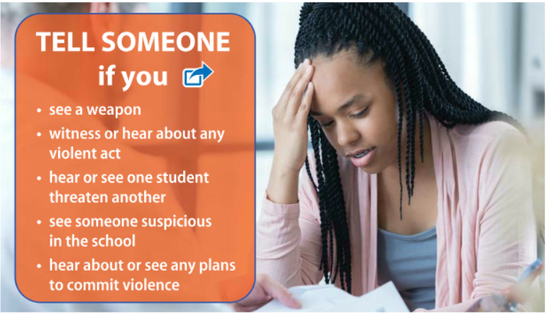
Dangerous Situations (video)

Slide 52
Human Trafficking
Human trafficking is a form of modern slavery in which people are forced to perform some type of job or service against their will
  Victims suffer mental and physical abuse
  To reduce human trafficking, do not walk alone in public, give out your personal information, or talk to strangers

Slide 53
Hate Crimes
Hate crimes are threats or attacks against someone because of his or her race, ethnic origin, disability, sexual orientation, or religion
Most states have laws punishing these
To reduce hate crimes, do not engage in prejudice and appreciate diversity
race
ethnic origin
disability
sexual orientation
religion

Slide 54
Homicide
Crime of killing another person is called homicide
  Very serious crime for which young people in some states spend life in prison
  Robs a person of his or her life, and devastates families, friends, and communities
  Reporting violent behavior and threats can help prevent homicides

Slide 55
Terrorism
The use of violence and threats to frighten and control groups of people to further an ideological aim is called terrorism
  Aims to punish people for or convince people of certain ideas
  Report suspicious objects, situations, or people to authorities to prevent terrorist attacks

Slide 56
Victims of Violence
If someone uses or threatens you with violence, tell a trusted adult
  If it is a romantic partner, get out of this relationship as soon as possible
  Also talk to an adult if you witness violence of any kind
Seek professional help for physical and psychological injuries

Slide 57
Violence Prevention
Stopping violence starts with you
  Resist the pressure to hurt other people and support others to do the same
  Practice healthy conflict resolution
  Learn to control your emotions, like anger
  Choose your friends carefully
  Do not pick up a gun or weapon

Slide 58
Lesson Review
Groups of people who commit violent and illegal acts are _____.
  gangs
Which parts of a person’s identity can be the targets of hate crimes?
  race, ethnic origin, disability, sexual orientation, or religion

