Slide 2
14
Promoting Healthy Relationships

Slide 3
14

Slide 4
Essential Question
How do you promote healthy relationships with your family, friends, and dating partners?

Slide 5
14.1
What Is a Healthy Relationship?

Slide 6
Learning Outcomes
After studying this lesson, you will be able to
discuss the importance of relationships for physical, emotional, and social health.
identify the characteristics of a healthy relationship.
identify signs of an unhealthy relationship.
(continued)

Slide 7
Learning Outcomes
After studying this lesson, you will be able to
explain how to communicate effectively with others.
summarize the process of negotiation to resolve conflicts.
describe the purpose of peer mediation.

Slide 8
Relationships

Slide 9
Healthy Versus Unhealthy Relationships
In a healthy relationship, you should feel
In an unhealthy relationship, you may feel
safe and secure
loved and valued
free to be yourself
acknowledged
understood
confident
anxious
angry or resentful
sad
pressured
used or ignored
unsafe

Slide 10
Healthy Relationships
Healthy relationships share the following important characteristics:
Honesty and trust
Mutual respect
Care and commitment
Emotional control
Understanding
Good interpersonal skills- Abilities that help people communicate and relate in positive ways with others

Slide 11
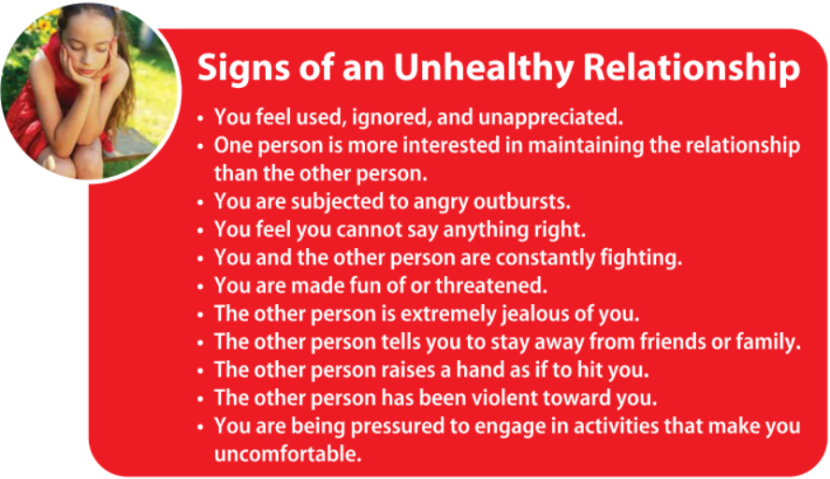
Unhealthy Relationships

Slide 12
Communication Skills
The exchange of messages and responses between two or more people is the communication process
Feedback- constructive response to a message to communicate that it was received and understood
Can include verbal communication- use of words to send a spoken or written in message and nonverbal communication- sending of messages through facial expressions, body language, gestures, tone and volume of voice, and other signals that do not involve the content of words

Slide 13
Communication Skills

Slide 14
Communication Skills
Verbal communication
Nonverbal communication
In-person conversation
Texting or phone calls
Social media and e-mail
Eye contact, facial expressions, and posture
Gestures (nodding, moving hands)
Tone, volume, and pitch of voice

Slide 15
Skills Check
Ways to communicate effectively
Use active listening- way of paying attention to spoken messages with the goal of understanding the message and the speaker’s feelings about it
Use assertive I-statements instead of aggressive you-statements
Clearly express your preferences and feelings in an assertive way
Be aware of your nonverbal cues like facial expressions and body language
Make sure that messages sent online are clear

Slide 16
Skills Check(video)

Slide 17
Passive, Aggressive ,or Assertive

Slide 18
Use I-Statements

Slide 19
Conflict Resolution Skills
Conflicts are present even in healthy relationships
Can stem from misunderstandings or different priorities, values, goals, or needs
How conflict is resolved determines how healthy a relationship is
(continued)

Slide 20
Conflict Resolution Skills

Slide 21
Conflict Resolution Skills
One method of resolving conflicts is negotiation
Keep calm
State your position
Listen to everyone’s perspective
Compromise
Ask for help, if needed
Prepare
(continued)

Slide 22
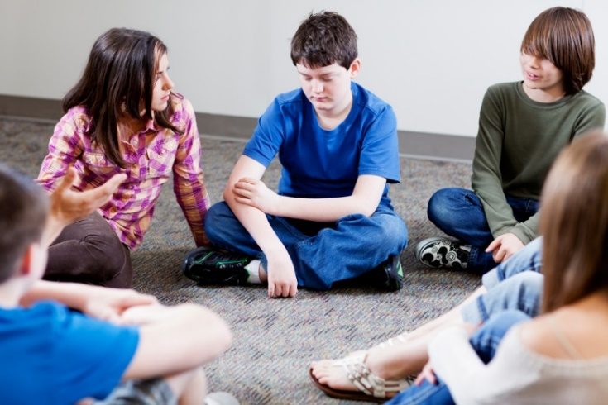
Conflict Resolution Skills
Some conflicts are too serious or difficult to manage without mediation
Many schools provide peer mediation- process in which specially trained students work with other students to resolve conflicts
iStock.com/Alina555

Slide 23
Lesson Review
True or false? If you feel used, ignored, or underappreciated, this is a sign that a relationship needs to change or end.
true
Which skill involves paying attention to what a person is saying in order to understand his or her feelings?
active listening

Slide 24
14.2
Family Relationships

Slide 25
Learning Outcomes
After studying this lesson, you will be able to
analyze the functions of the family.
explain the role of community in supporting families.
(continued)

Slide 26
Learning Outcomes
After studying this lesson, you will be able to
identify strategies to promote healthy relationships with parents or guardians and siblings.
describe various changes that occur within families and ways to adjust to them.

Slide 27
Family Relationships
Healthy immediate family- person’s parents or guardians and siblings- relationships
provide for physical needs, including food and drink, shelter, medical care, and clothing
meet mental and emotional needs
Socialize (teaching children to behave in socially acceptable ways) children and educate them about cultural traditions (specific patterns of behavior passed down in a culture) and rituals (series of actions performed as part of a ceremony)

Slide 28
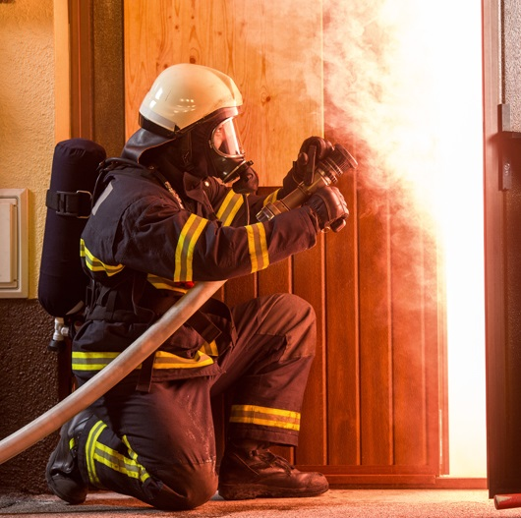
Health Alert!
Community resources can give extra support to families
Fire and police departments, clinics, hospitals, public schools, and government agencies such as food pantries or homeless shelters
urbans/Shutterstock.com

Slide 29
Relationships with Guardians
Many young people experience conflict with caregivers, parents, or guardians
Parents may set rules to keep young people safe, but youth find these rules limiting due to a new desire for independence
Conflicts may also develop due to media influences from TV or movies

Slide 30
Skills Check
Maintaining healthy relationships with parents or guardians
Get approval before you commit to plans. Answer any questions your guardian may have and revise the plan if needed
Discuss family rules and expectations and calmly explain if you think a rule should change and why
Follow your parent’s rules, even if you disagree with them
Do not resort to yelling or walking away during a disagreement to show that you can be responsible
Spend time doing enjoyable activities with your family

Slide 31
Sibling Relationships
Conflicts among siblings are common
Due to having different personalities, interests, and ways of handling major life events
Competitions called sibling rivalry- competition with a brother or sister- may lead to negative feelings such as anger or jealousy

Slide 32
Skills Check
Maintaining healthy sibling relationships
Express how you feel to your sibling and to your parent or guardian
Compromise when issues arise
Identify personal space for each person and respect your sibling’s space and privacy
Find enjoyable ways of spending time together
Get away from tense situations and cool down

Slide 33
Skills Check

Slide 34
Changes in Family Relationships
Positive and negative changes can create stress and disrupt family relationships
Healthy families can work through these changes together
Job changes and promotions
New schools
Changes in health
Birth or adoption
Moves
Marriage or divorce
Death of a family member
(continued)

Slide 35
Lesson Review
True or false? Families have the responsibility to care for the mental and emotional needs of its members.
true
Competition with a brother or sister, called _____, can lead to negative feelings.
sibling rivalry

Slide 36
14.3
Peer Relationships

Slide 37
Learning Outcomes
After studying this lesson, you will be able to
distinguish between different types of friendships.
explain how to promote tolerance and celebrate diversity in relationships.
(continued)

Slide 38
Learning Outcomes
After studying this lesson, you will be able to
devise a plan to use strategies for building and maintaining healthy friendships.
evaluate common issues in friendships.
differentiate between positive and negative types of peer pressure.

Slide 39
Types of Friendships
Close friends
Casual friends
Acquaintances
Virtual friends
(continued)
Mat Hayward/Shutterstock.com; Rawpixel.com/Shutterstock.com; Syda Productions/Shutterstock.com; carballo/Shutterstock.com

Slide 40
Types of Friendships
Acquaintances- people you know and interact with, but may not consider friends
Virtual friends- people you meet through social media, web sites, chat rooms, or gaming

Slide 41
Types of Friendships
The inclusion of people with different backgrounds is diversity
Includes age, gender, family traditions, ethnicities, cultures, gender identities, and sexual orientations
Avoid making assumptions based on stereotypes- oversimplified ideas about a group of people

Slide 42
Strategies for Building Healthy Friendships
Make time for relationships, especially when you are busy
Try spending time in a group, doing an activity together, or talking throughout the day
Step away from the screen to form and maintain strong friendships

Slide 43
Skills Check
Tips for being a good friend
Avoid interrupting or criticizing while your friends talk
Support and encourage your friends, and celebrate their successes
Do not gossip or spread rumors
Work to solve disagreements and problems
Express your feelings openly during conflicts and listen to your friend’s point of view
Apologize if you hurt your friend, and try to find ways to make it better

Slide 44
Infographic Discussion
What can you do to stop the spread of gossip and rumors?

Slide 45
Common Problems in Friendships
A small group of friends who deliberately exclude other people from joining or being part of their group is a clique
Jealousy between friends is normal once in a while, but can build up over time if not talked about
Physical, emotional, and social changes can create distance between friends

Slide 46
Common Problems in Friendships

Slide 47
Peer Pressure
The influence people feel from peers can be positive or negative
(continued)

Slide 48
Peer Pressure
Young people may go along with peer pressure in an attempt to fit in or avoid being teased and excluded
Negative peer pressure does not occur in healthy friendships
You have the right to walk away from situations that make you uncomfortable

Slide 49
Peer Pressure

Slide 50
Skills Check
Responding to negative peer pressure
When someone pressures you do to something you are not comfortable with
Focus on your own feelings and values and make decisions that reflect your core beliefs
Have the self-confidence to walk away from a situation or from people who make you uncomfortable
Choose friends who have values similar to yours
Support other people when they resist peer pressure
Talk to a trusted adult about continued peer pressure over time

Slide 51
Lesson Review
What are four types of friendships?
close friends, casual friends, acquaintances, virtual friends
It is important to practice _____ and celebrate differences between people.
diversity
(continued)

Slide 52
Lesson Review
Conor’s friends purposely exclude Taylor from being a part of their group. What is this called?
clique
If someone encourages a young person to be the best they can be, this is _____ peer pressure.
positive

Slide 53
14.4
Dating Relationships

Slide 54
Learning Outcomes
After studying this lesson, you will be able to
describe the characteristics of a healthy dating relationship.
identify strategies to set boundaries for physical intimacy before and during a dating relationship.
(continued)

Slide 55
Learning Outcomes
After studying this lesson, you will be able to
follow strategies for forming a healthy dating relationship.
describe ways to handle the end of a dating relationship.

Slide 56
Dating Relationships
People feel ready to begin dating at different times
For young people, the decision to act on romantic feelings can be scary
Casual dating- way of getting to know how you interact with and feel about another person
(continued)

Slide 57
Dating Relationships
Healthy dating relationships include
Both emotional and physical attraction and closeness, not simply sudden infatuation- intense romantic feelings for another person that develop suddenly and are usually based on physical attraction
Individual personal values, beliefs, and self-esteem
Balance with other relationships and activities
Mutual honesty, respect, and open communication
Support for one another’s success, happiness, talents, interests, and goals
Feeling of safety for personal boundaries and well-being
(continued)
Joan Hall/Shutterstock.com

Slide 58
Dating Relationships
Over time, an intense affection for and attachment to one another may develop
Love should not be confused with passion- powerful feeling based on physical attraction, which is typically short-lived
As love develops, a healthy relationship should become exclusive- committed to being romantically involved with only one dating partner

Slide 59
Physical Intimacy and Abstinence
Dating relationships often include some type of physical intimacy- closeness, such as holding hands and kissing
You should know your limits and boundaries before you start dating
The commitment to refrain from sexual activity, abstinence, is the healthiest decision for young people

Slide 60
Health Alert!

Slide 61
Think About It…
What are some of the physical, emotional, and social benefits of refraining from sexual activity as a young person?
iStock.com/kali9

Slide 62
Skills Check
Tips for healthy dating relationships
Get to know the person before dating
Talk to this person at school, during an activity, or on the phone before going on a date to see if you share common interests
Group dating- going out with a group that includes the person one is interested in rather than dating as a couple, is a low-stress method of getting to know a potential dating partner
Plan activities that do not make you nervous, like seeing a movie, playing mini golf or bowling, or going to a school dance

Slide 63
Healthy Dating Relationships

Slide 64
The End of a Dating Relationship
Young people are still figuring out their identities, which can lead to breakups
It is important to recognize when a relationship is not working, even if it is sad or painful
People need time after a breakup to process their feelings before beginning a new relationship

Slide 65
Lesson Review
Going on a date without being in a dating relationship is called _____.
casual dating
Why are infatuation and passion typically short-lived?
based on physical attraction alone

