Slide 2
13
Protecting Environmental Health

Slide 3
13

Slide 4
Essential Question
How is your health influenced by the environment in which you live?

Slide 5
13.1
Common Hazards in the Environment

Slide 6
Learning Outcomes
After studying this lesson, you will be able to
describe different types of air pollution and their effects.
assess causes of water pollution and ways to keep water safe.
(continued)

Slide 7
Learning Outcomes
After studying this lesson, you will be able to
identify types of chemicals that are harmful to the environment.
explain how to handle chemicals safely.
recognize the health dangers of noise pollution and how to avoid them.

Slide 8
The Environment

Slide 9
Air Pollution
Air contains oxygen and other gases people need to survive
Sometimes, air contains pollutants- Substances that contaminate the environment and can harm people
Human activity can cause smog- Fog that has mixed with smoke and chemical fumes in urban environments
Polluting gases can fall as acid rain- Any form of precipitation that includes particles containing acid
(continued)

Slide 10
Air Pollution

Slide 11
Air Pollution
Indoor air can also contain pollutants
Can be caused by paint, tobacco smoke, cleaning products, pet dander, and dust
Dust mites, found in about 80 percent of homes, can trigger allergic reactions and asthma attacks
(continued)

Slide 12
Air Pollution
Air pollution can cause health problems
Can also damage the ozone - Gas made up of oxygen that naturally exists high above earth’s atmosphere, which can cause skin cancer
Cancer
Heart disease
Respiratory diseases
Irritation of eyes, nose, throat

Slide 13
Air Pollution
Climate change is caused by air pollution
Can lead to shifting weather patterns
Can cause natural disasters such as heat waves, droughts, and floods
Rising temperatures will melt surface ice, which can raise sea levels

Slide 14
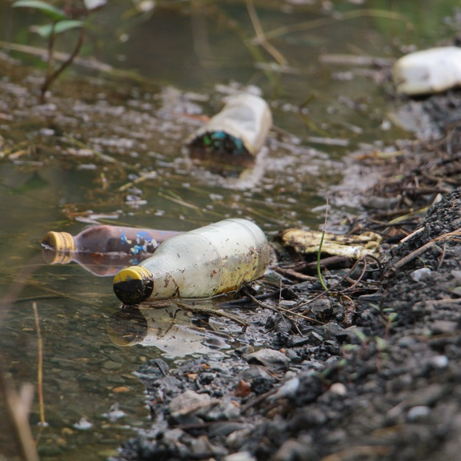
Health Alert!
Only about 1% of the water on Earth is available to use as drinking water
If this water becomes polluted by human-made chemicals and pollutants or natural disasters, it is no longer safe to drink
Bankolo5/Shutterstock.com

Slide 15
Water Pollution
Runoff water picks up loose soil and pollutants as it travels over the ground
These pollutants can include
pesticides and fertilizers
oil, grease, and chemicals from vehicles
metals and chemicals from factories and construction sites
(continued)

Slide 16
Water Pollution (video)

Slide 17
Water Pollution
Natural disasters can cause pollution
Hurricanes and floods can sweep raw sewage, fertilizers, chemicals, and oil into waterways
Tsunamis can flood an area with salt water and destroy farmland
These disasters can contaminate a town’s drinking water

Slide 18
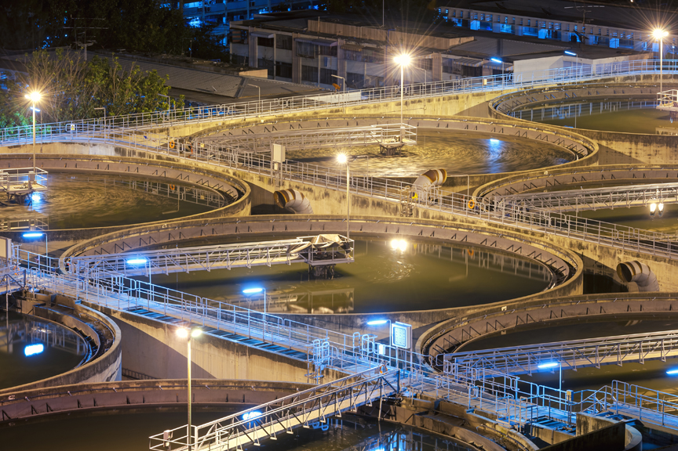
Health Alert!
Water treatment plants remove pollutants and clean water before it is returned to homes, farms, or industries
arhendrix/Shutterstock.com

Slide 19
Chemicals
Some chemicals are safe to use in reasonable amounts, like minerals and vitamins
Other chemicals can make people sick
Mercury, lead, BPA, arsenic, and pesticides
Exposure can lead to nausea, vomiting, skin or eye problems, and cancer

Slide 20
Skills Check
Chemical use safety tips
Read labels carefully before using
Be careful about mixing chemicals together
Wear gloves and protective eyewear
Use chemicals outside or open windows
Store and dispose of chemicals properly

Slide 21
Chemicals

Slide 22
Noise Pollution
Noise is sound that bothers a person
High levels of noise over a period of time can lead to hearing loss
Increases stress and high blood pressure
Can impact sleep and productivity

Slide 23
Lesson Review
Fog mixed with smoke and chemical fumes is a type of air pollution called _____.
smog
Where is water sent to make it clean for drinking?
water treatment plant
True or false? All chemicals are harmful.
false

Slide 24
13.2
Pollution Prevention and Greener Living

Slide 25
Learning Outcomes
After studying this lesson, you will be able to
give examples of federal and state laws that protect the environment.
describe what the environmental protection hierarchy is and how to use it.
(continued)

Slide 26
Learning Outcomes
After studying this lesson, you will be able to
determine strategies you can use to reduce energy consumption and conserve natural resources at home.
identify ways to be green at school.
explain green choices people can make when traveling.

Slide 27
Protecting the Environment
Environmental Protection Agency (EPA)
Federal government agency
Sets rules and regulations to protect the environment and people’s health
Pollution is measured on the Air Quality Index (AQI)- Number that communicates to the public the level of pollutants in the air
(continued)

Slide 28
Protecting the Environment
Examples of EPA regulations include
Clean Air Act
Safe Drinking Water Act
Resource Conservation and Recovery Act
Land revitalization programs to clean up brownfield sites- Land, such as an old factory or gas station, which contains hazardous waste

Slide 29
Think About It…
Earth Day is celebrated on April 22.
What can you do on your own or in your school to support taking care of the planet?
best works/Shutterstock.com

Slide 30
The Environmental Protection Hierarchy
The environmental protection hierarchy outlines ways to live greener
Most preferred methods are at the top
Reduction
Recycling
Treatment
Disposal

Slide 31
Reduction
Reduce the amount of trash created
Turn off lights when leaving a room
Turn off water while brushing teeth
Reduce use of fossil fuels - Natural forms of energy, such as oil, natural gas, and gas, which were formed a very long time ago, when dinosaurs lived on Earth
Use renewable energy - Type of energy that cannot be used up, such as wind, water, or solar power
Buy used books or clothing instead of new

Slide 32
Reduction

Slide 33
Recycling
Instead of throwing items away, consider recycling - Process in which used materials are turned into new products
Use reusable bags or water bottles
Buy rechargeable batteries
Donate used items instead of throwing them away

Slide 34
Recycling

Slide 35
Treatment and Disposal
Treatment involves making hazardous substances less dangerous
Sewage is treated to avoid the effects of human waste entering the environment
Some unsafe materials must be disposed of carefully
Batteries, tires, medical waste

Slide 36
Greener Living
“Green” living protects the environment
Involves conserving resources and limiting or preventing actions that pollute
One goal is to create sustainability - Actions that maintain the natural resources in the environment
People can take greener actions at home, school, work, and in their community

Slide 37
Infographic Discussion
How can you advocate for a greener planet in your school or community?

Slide 38
Skills Check
Use less energy to conserve resources
Turn off lights when leaving a room
Shut the refrigerator when you select what you need
Keep doors and windows closed when using heating or air conditioning
Buy energy-efficient products, including lightbulbs

Slide 39
Greener Living
Make wise purchases such as green products - Goods that have a less harmful impact on the environment than traditional products, which are
made of recycled materials
obtained from local stores or farms
made without harmful chemicals
biodegradable - able to break down without causing harm when thrown out
(continued)

Slide 40
Greener Living
Reduce food waste by
buying only what you expect to eat
storing food so that it stays fresh longer
taking home leftover food from restaurants so it does not go to waste
having a “leftovers” night each week
composting - process of gathering food scraps and yard waste into a bin and letting it decompose and then adding it to soil to help plants grow
(continued)

Slide 41
Greener Living
Plant a tree
Improves air quality by releasing oxygen and absorbing other gases
Holds water in the soil, preventing runoff
Be green when away from home, while at school, or when traveling

Slide 42
Skills Check
Be more green at school
Take reusable containers for food and drinks in school lunches
Recycle any cans or bottles you use
Take only the condiments or napkins you need from the cafeteria
Participate in a community composting program
Walk or ride your bike to school
If you need to ride in a car, carpool with others

Slide 43
Lesson Review
What is the federal government agency that sets regulations to protect the environment and people’s health?
Environmental Protection Agency (EPA)
The second highest approach in the environmental protection hierarchy is _____.
recycling
(continued)

Slide 44
Lesson Review
Solar power, wind power, and water power are examples of _____ energy.
renewable
Nadia recycles her disposable water bottle at the end of every day. How can Nadia live greener?
use a reusable water bottle

