Slide 2
12
Preventing and Responding to Accidents and Injuries

Slide 3
12

Slide 4
Essential Question
How can you protect yourself at home, in the community, and online?

Slide 5
12.1
Staying Safe in the Home

Slide 6
Learning Outcomes
After studying this lesson, you will be able to
give examples of ways to prevent falls in the home.
explain how to prevent illness or injury from potentially hazardous products in the home.
(continued)

Slide 7
Learning Outcomes
After studying this lesson, you will be able to
describe how the presence of weapons in the home increases the risk of serious injuries.
create an escape plan for leaving your home in case of a fire.
(continued)

Slide 8
Learning Outcomes
After studying this lesson, you will be able to
develop an emergency preparedness plan for your family.
identify ways to remain safe when staying home alone.

Slide 9
Home Safety
Actions you take to prevent something bad from happening are called precautions
Families can take precautions against falling, poisoning, weapons, fires, and emergencies

Slide 10
Skills Check
Clear the floors and stairs of clutter
Keep electrical cords away from walkways
Install handrails for stairs
Use stepstools or ladders to reach high shelves or cabinets
Replace burned lightbulbs and use night-lights
Repair or replace worn carpet edges
Reduce the risks of falls in your home

Slide 11
Poisoning Prevention
Many chemicals are poisonous and are able to cause illness or death upon entering the body if used or disposed of incorrectly
Poisonous household products may include
carbon monoxide
fertilizers and pesticides
cleaning supplies
gasoline or antifreeze
medication

Slide 12
Weapons Safety
To prevent accidents, adults should
keep guns locked in a safe place out of reach of children
remove bullets and store separately from the gun
asiandelight/Shutterstock.com

Slide 13
Health Alert!
If you see a gun, follow these steps
Leave
the area without touching the gun
Tell
a trusted adult about the gun
Report
anyone who was using or playing with the gun

Slide 14
Fire Prevention and Safety (video)
The fire triangle- model to help you remember the elements that are needed for a fire to occur; elements include fuel, heat, and oxygen
Materials that are easily set on fire are flammable
By removing one element of
the fire triangle, you can
extinguish- put out- the fire
(continued)
BALRedaan/Shutterstock.com

Slide 15
Skills Check
Conduct a fire safety inspection in your home
No smoking inside the home
Candles are never left unattended
Working smoke detectors are outside all sleeping areas and in the kitchen
Pots and pans are never left unattended on a hot stove
All electrical cords are checked regularly
Electrical appliances that are not in use are unplugged

Slide 16
Fire Prevention and Safety
Have an escape plan- strategy that outlines safe routes and proceed years for leaving the house in the event a fire occurs- with your family
Find two ways to exit each room
Define a place for all family members to meet once safely out of the home
Practice this plan with your family

Slide 17
Fire Prevention and Safety

Slide 18
Emergency Preparedness
Having emergency preparedness- knowing how to respond to a specific type of emergency- is important to keeping families safe
Examples of emergencies you may experience are natural disasters- events or forces of nature that usually cause great damage
Other emergencies include power failure, landslide, wildfire, and terrorism
(continued)

Slide 19
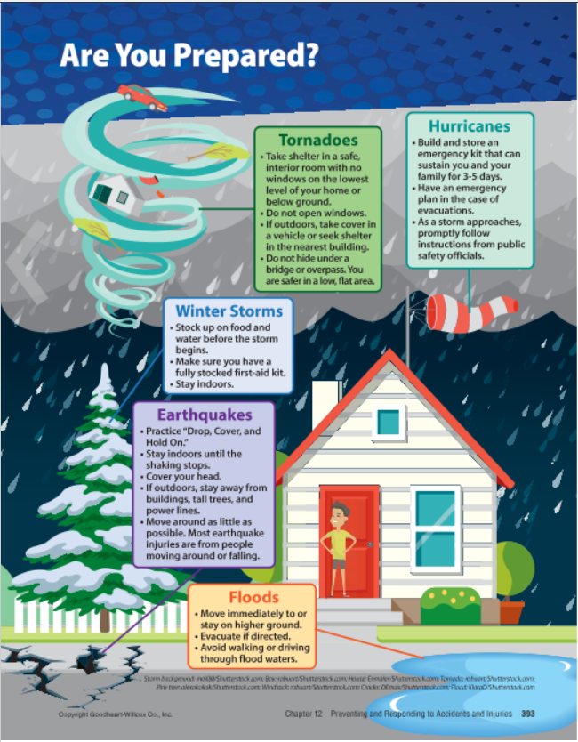
Infographic Discussion
Which natural disasters are possible in your environment?

Slide 20
Emergency Preparedness
Plan for common problems associated with emergencies
Store supplies, such as a flashlight, first-aid kit, nonperishable food, or bottled water, in your home or car
Have a plan for how you will take shelter and communicate with your family

Slide 21
Emergency Preparedness

Slide 22
Safety When Home Alone
Rules for staying home alone
Call your guardian when you get home
Do not go anywhere else or invite people over without permission
Keep all doors and windows locked
Do not turn on the oven
Do not tell anyone you are home alone

Slide 23
Lesson Review
Substances that can cause illness or death upon entering a body are _____.
poisonous
Austen is home alone when the doorbell rings. She can see a delivery woman on the front porch. What should Austen do?
keep the door locked and do not let anyone know she is home alone

Slide 24
12.2
Staying Safe in the Community and Online

Slide 25
Learning Outcomes
After studying this lesson, you will be able to
describe safety precautions you can take to stay safe at school.
give examples of ways you can stay safe in public places.
(continued)

Slide 26
Learning Outcomes
After studying this lesson, you will be able to
demonstrate how to protect your privacy and safety online.
explain precautions you can take to stay safe on the road.
identify ways to stay safe while participating in outdoor activities.

Slide 27
Staying Safe at School
Schools have rules and procedures in place to protect students
Use safety equipment during sporting events and P.E. classes
Alert staff to emergencies, such as the presence of weapons

Slide 28
Staying Safe in Public Places
Keep your guardian informed
Let your parent or guardian know where you are going, how you will get there, and when you will be home
Take precautions
Carry a charged cell phone
Take only enough money for your needs
Travel in well-lit areas and with other people whenever possible
Be cautious with strangers- people whom you do not know
Do not go anywhere with strangers
Get away from anyone who makes you uncomfortable

Slide 29
Staying Safe on the Internet
Keep your personal information private
Avoid hackers- people who illegally access data in your computer- by keeping your passwords private and not opening suspicious links
Limit using personal information online to avoid identity theft- stealing and using someone’s personal identifying information, often for financial gain

Slide 30
Think About It…
Why should you not tag yourself or others in online content that includes your
name
location
school’s name
home address?
Brilliantist Studio/Shutterstock.com

Slide 31
Staying Safe on the Internet
Be careful on social media
Set profiles to “private” so only approved people can see your content
Do not post anything online that you would not want everyone to see
If you meet someone online, do not get together in person without your guardian present
(continued)

Slide 32
Infographic Discussion
Is there more you can do on social media to protect your privacy?

Slide 33
Staying Safe on the Internet
Do not share inappropriate photos, videos, or messages
Even private messages are easily shared with other people
Block or report any online activity that makes you feel uncomfortable or unsafe

Slide 34
Staying Safe on the Road
People walking, running, or bicycling along a road, are a pedestrian
When riding in a car, wear a seatbelt and make sure the driver is not distracted
If you see your driver texting, ask him or her to stop

Slide 35
Skills Check
When walking or running, face toward traffic and use sidewalks when possible
Wear reflective clothing at night
Pedestrian Safety
When biking, face away from traffic and always wear a properly fitting helmet
Obey all traffic signals and traffic rules
Always assume that drivers do not see you

Slide 36
Staying Safe in the Water
Water-safety tips include
Never leave children alone in or near water
Do not dive in shallow water
Avoid swimming in really cold water
Never swim in unsupervised water
If you believe someone is drowning, call 911

Slide 37
Lesson Review
True or false? Traveling in well-lit areas can help you stay safe in public places.
true
People who illegally access data on electronic devices are _____.
hackers
What are people on the road called?
pedestrians

Slide 38
12.3
Knowing Basic First Aid

Slide 39
Learning Outcomes
After studying this lesson, you will be able to
identify items needed in a first-aid kit.
describe the three steps you should take after determining that you can help someone in need of first aid.
(continued)

Slide 40
Learning Outcomes
After studying this lesson, you will be able to
summarize ways to provide treatment for various common injuries.
explain what a medical emergency is and how you should respond to one.

Slide 41
Basic First Aid
In the event of an accident or injury, a person can be treated with first aid- treatment given in the first moments of an accident or injury – usually before medical professionals arrive on the scene
A first-aid kit- container that includes the supplies needed to treat most types of minor injuries
First-aid kits should be kept in the home and in vehicles
(continued)

Slide 42
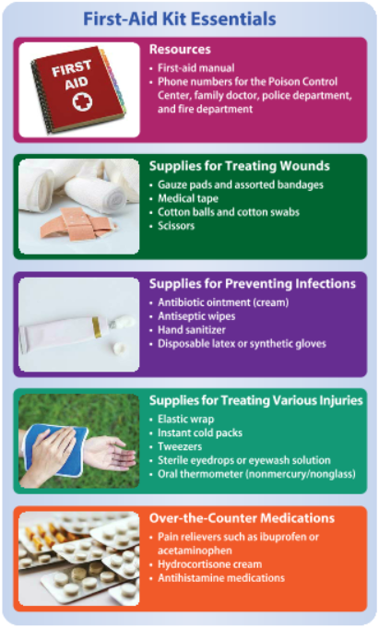
Health Alert!

Slide 43
Basic First Aid
Check if the victim’s injury appears life threatening
Severe bleeding, labored or no breathing, shock, or unconsciousness
Call 911, or have a bystander- someone who is at an event or incident, but is not directly involved call 911
If possible, obtain consent to give first aid

Slide 44
Treatment for Common Injuries
People who perform first aid should follow standard precautions- infection control practices that apply when giving first aid to any person under any circumstances to protect themselves
Wear protective gloves when at risk of contact with blood or bodily fluids
Wash hands with soap and water after giving first aid
(continued)

Slide 45
Treatment for Common Injuries
If the bleeding does not stop on its own, follow these steps for cuts, scrapes, and puncture wounds
Deep cuts may require stitches
Apply pressure using a sterile bandage
Flush the wound with clean water
Apply an antibiotic cream or ointment
Apply a bandage and change it daily
(continued)

Slide 46
Treatment for Common Injuries
For severe bleeding,
apply pressure to wound
position the wound higher than the heart
dress the wound
keep the victim calm
treat the victim for shock
(continued)

Slide 47
Treatment for Common Injuries

Slide 48
Treatment for Common Injuries
People may experience bites from domestic or wild animals
Require a doctor’s attention because they carry the risk of infection
Before you see the doctor, wash with soap and water, cover with a clean bandage, and elevate the wound
(continued)

Slide 49
Treatment for Common Injuries
Insect bites
Mild swelling or itching is a normal reaction to insect bites
Treat with cool cloths, calamine lotion, or hydrocortisone cream
Treat more severe reactions with ice, pain relievers, elevation, and rest
A life-threatening allergic reaction called anaphylaxis- allergic response in which fluids fill the lungs and air passages narrow, restricting breathing- requires emergency care
(continued)

Slide 50
Rash/Hives

Slide 51
Allergic Reactions

Slide 52
Treatment for Common Injuries
Electrical shock
Call 911, administer CPR, and cover the person with a blanket
Burns
Can be first-, second-, or third-degree
Treatment ranges from covering the burn to calling 911
(continued)

Slide 53
Burns

Slide 54
Responding to Medical Emergencies
An urgent, life-threatening situation is a medical emergency
Call 911 right away then follow emergency first-aid treatment
For choking, follow the five-and-five method of alternating back blows and abdominal thrusts
(continued)

Slide 55
Responding to Medical Emergencies

Slide 56
Choking

Slide 57
Responding to Medical Emergencies
Restore heartbeat or breathing with cardiopulmonary resuscitation (CPR)- emergency procedure that uses chest compressions to restore heartbeat; may also involve mouth to mouth breathing
Full CPR involves mouth-to-mouth breathing, which requires training
Anyone can perform Hands-Only CPR
An automated external defibrillator (AED)- rescue device that delivers a controlled, precise shock to the heart- can also help restore heartbeat

Slide 58
CPR

Slide 59
AED

Slide 60
Lesson Review
The treatment given usually before medical professionals arrive is _____.
first aid
What are some signs that a person’s injury is life threatening?
severe bleeding, labored or no breathing, shock, and unconsciousness
(continued)

Slide 61
Lesson Review
What are the three types of burns?
first-, second-, and third-degree
Full _____ involves mouth-to-mouth breathing and chest compressions.
cardiopulmonary resuscitation (CPR)

