Slide 2
11
Understanding and Preventing Diseases

Slide 3
Essential Question
What causes communicable and noncommunicable diseases, and how can you prevent them?

Slide 4
11.1
Communicable Diseases

Slide 5
Learning Outcomes
After studying this lesson, you will be able to
understand the nature of communicable diseases.
explain the types of pathogens that can make you sick.
(continued)

Slide 6
Learning Outcomes
After studying this lesson, you will be able to
describe the different methods of disease transmission.
understand common communicable diseases.
describe treatment methods for communicable diseases.

Slide 7
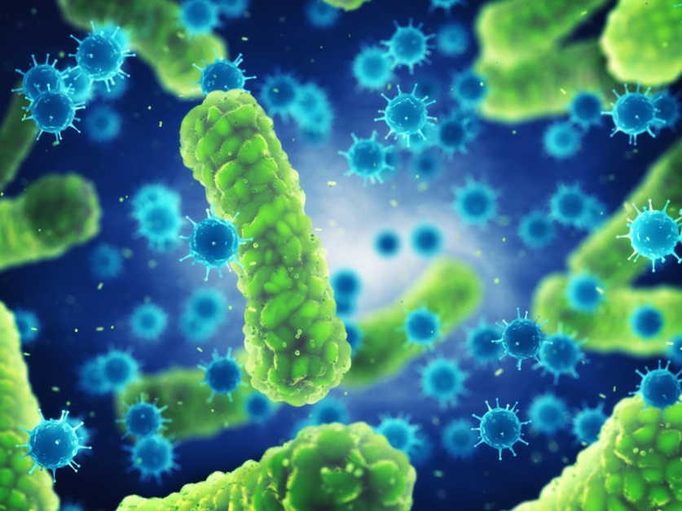
Understanding Communicable Disease
Communicable diseases- (Condition someone can develop after coming into contact with humans, animals, or plants infected with the disease; also called infectious disease) are infectious, which means they can be transmitted to you
Develop after contact with humans, animals, or plants with a disease
Caused by pathogens-
Microorganisms that cause
communicable diseases , or germs
nobeastsofierce/Shutterstock.com

Slide 8
Types of Pathogens
Bacteria
Live in almost every place where life can thrive
Viruses
Depend on other cells’ resources for growth
Quickly multiply to cause a virus
Fungi
Live in damp, warm places
Only a few cause disease
Most bacteria are helpful
Protozoa
Single-celled organisms that live everywhere
A few cause extremely dangerous diseases

Slide 9
Viruses

Slide 10
Methods of Transmission
Pathogens can travel from one source to another in a few ways
Droplet spread
Direct contact transmission
Vectors, or animals
Food and drinking water
Contaminated objects
Airborne contamination
Methods of transmission- Way a disease gets from one organism to another; maybe direct or indirect

Slide 12
Common Communicable Diseases
Influenza (the flu) is a viral infection of the respiratory system
Mononucleosis- Common viral infection that spreads through kissing or by sharing certain objects; also known as mono and the kissing disease
(continued)

Slide 13
Common Communicable Diseases

Slide 14
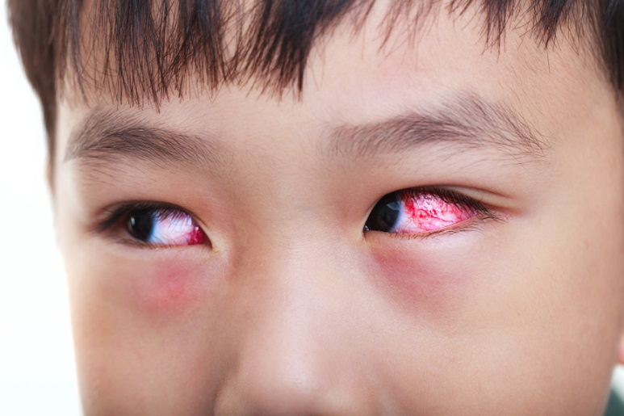
Common Communicable Diseases
Tonsillitis- Bacterial or viral infection that affects the tonsils -causes sore throat, fever, and painful swallowing
Conjunctivitis- Viral or
bacterial infection that
causes inflammation of
part of the eye; also known
as pinkeye
kdshutterman/Shutterstock.com

Slide 15
Common Communicable Diseases (Tonsillitis)

Slide 16
Treating Communicable Diseases
To treat bacterial infections, many doctors prescribe antibiotics- Substances that target and kill pathogenic bacteria
The best treatment methods for viral infections include rest, good nutrition, and fluids
Medications can treat symptoms, but not the virus itself

Slide 17
Lesson Review
The germs that cause communicable diseases are called _____.
pathogens
Which pathogen uses a cell’s resources and energy to grow and reproduce?
virus
(continued)

Slide 18
Lesson Review
What are the scientific names for the common communicable diseases mono, pinkeye, and the flu?
mononucleosis, conjunctivitis, and influenza
True or false? Certain medications can help get rid of a viral infection.
false

Slide 19
11.2
Sexually Transmitted Infections (STIs)

Slide 20
Learning Outcomes
After studying this lesson, you will be able to
understand how people contract sexually transmitted infections (STIs).
describe the most commonly reported STIs.
identify potential STI resources.
explain treatment methods for STIs.

Slide 21
Sexually Transmitted Infections
Communicable diseases that spread from one person to another during sexual activity are called sexually transmitted infections (STIs)
Engaging in sexual activity one time is all it takes to contract an STI
People with more sexual partners have greater chances of getting an STI

Slide 22
Common STIs
Chlamydia- Bacterial infection known as the “silent” disease because it has few or no symptoms, which means it often goes undiagnosed
Can progress to pelvic inflammatory disease (PID) in women which can cause infertility
Can be treated and cured with antibiotics
(continued)

Slide 23
Common STIs
A bacterial infection that primarily affects the genitals, rectum, and throat is gonorrhea
Common among people between 15 and 24 years of age
Typically few symptoms, but any that do develop vary between males and females
(continued)

Slide 24
Common STIs
Syphilis- Bacterial infection divided into stages that causes extremely serious health problems and a disability
Develops in stages of sores and a rash
Can be cured through antibiotics
Uncured, late-stage syphilis can cause brain damage, paralysis, and fatal heart, liver, and blood vessel damage
(continued)

Slide 25
Common STIs (Syphilis)

Slide 26
Common STIs
Trichomoniasis- Curable infection caused by protozoa that is more common among young women than men
Extremely curable with prescription drugs
More common among women than men
Men often show no symptoms, but can reinfect sexual partners
(continued)

Slide 27
Common STIs
Two kinds of herpes simplex virus cause genital herpes- Viral infection that results in sores on the genitals
Usually mild or no symptoms
Outbreaks include blisters that appear at the infection site, burst, heal, and return
No cure, but medication can control outbreaks
(continued)

Slide 28
Common STIs

Slide 29
Common STIs
Human papillomavirus (HPV)- Most commonly contracted STI that causes genital infections and sometimes cancer
The body fights and eliminates most HPV viruses
HPV viruses can cause genital warts or cervical cancer
An HPV vaccine can reduce the risk for infection

Slide 30
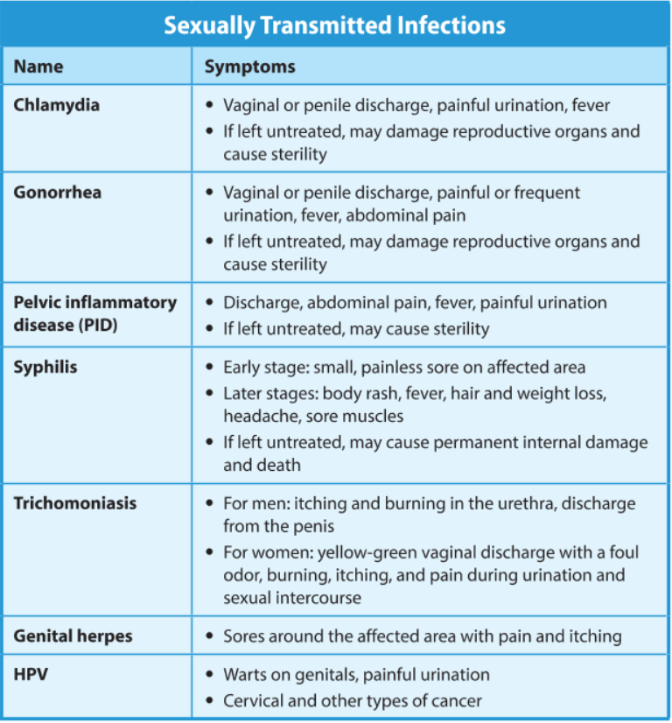

Slide 31
Think About It…
The only 100 percent effective way to prevent STIs is to practice abstinence- Commitment to refrain from sexual activity; only method of that is 100% effective in preventing STI’s
What are some influences that might prevent young people from practicing abstinence?

Slide 32
Skills Check
Sexual activity refusal skills
Practice
Refuse
Seek advice
Use a short, simple, honest, assertive response
You may also walk away from the situation
Remember that you do not need to face this alone
Talk to a trusted adult for guidance
Reflect on potential risky situations
Consider the words you might use ahead of time

Slide 33
Treating STIs
Most STIs are easily treated, especially in their early stages
Treatment does not make a person immune to STIs
Viral STIs can be controlled but not cured with antiviral medications
A person can also still contract a different STI
A person can contract this STI again if exposed to it another time
Bacterial STIs are treatable through antibiotics

Slide 34
STI Resources
Doctors can provide tests for STIs and provide treatment
Public and private health programs often cover diagnosis, treatment, and prevention
Some schools may provide sexual health and wellness programs

Slide 35
Lesson Review
True or false? Sadie cannot contract an STI from engaging in sexual activity just one time.
false
While _____ is the only 100 percent effective method for preventing STIs, a _____ can also reduce the chances.
abstinence; latex condom

Slide 36
11.3
HIV/AIDS

Slide 37
Learning Outcomes
After studying this lesson, you will be able to
distinguish between HIV and AIDS.
understand the transmission of HIV.
describe the signs and symptoms of HIV/AIDS.
(continued)

Slide 38
Learning Outcomes
After studying this lesson, you will be able to
explain testing procedures for diagnosing HIV/AIDS.
identify treatment methods for HIV/AIDS.

Slide 39
Understanding HIV and AIDS
HIV
The human immunodeficiency virus (HIV) )- Virus that infects and kills cells, weakening the body’s immune system; leads to AIDS
AIDS
Sometimes, HIV leads to acquired immunodeficiency syndrome (AIDS)
Does not always lead to AIDS, but can in some cases
This is an often fatal disease in which the body cannot fight infections and diseases
(continued)

Slide 40
Understanding HIV and AIDS
Status determined by a laboratory test that indicates the presence of HIV antibodies in a person’s blood -this person is HIV-positive
This does not necessarily mean that a person has or will have AIDS

Slide 41
HIV Transmission
HIV can be found in
HIV is not found in
blood (including needles for drugs, tattoos, or piercings)
semen
vaginal fluids
breast milk
open sores on skin, in the mouth, or on genitals
tears
saliva (kissing, spitting, sharing food)
sweat
mosquitos
healthy, intact skin (shaking hands, using the same toilet seat, etc.)

Slide 42
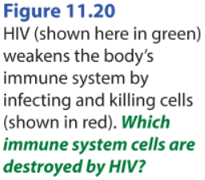
HIV

Slide 43
Signs and Symptoms of HIV/AIDS
Early symptoms of HIV include fatigue and swollen, painful lymph nodes
HIV destroys immune system cells, which cause opportunistic infections- Conditions that occur when pathogens take advantage of a weakened body; the cause of death in HIV/AIDS cases
HIV-positive people whose infection progresses to AIDS slowly are long-term non-progressors

Slide 44
Health Alert!
Modern medication can greatly extend an HIV-positive person’s life span

Slide 45
Testing for HIV/AIDS
HIV testing is the key to controlling HIV/AIDS transmission
Quick tests are available in doctors’ offices and hospitals
An over-the-counter version to use at home is available at some drug stores

Slide 46
Testing for HIV/AIDS

Slide 47
Preventing and Treating HIV/AIDS
The same methods used to prevent other STIs also help prevent HIV/AIDS
Abstinence is 100 percent effective
HIV/AIDS is treated with anti-retroviral therapy (ART)- (Treatment for HIV/AIDS in which a cocktail of three drugs is given to interfere with HIV reproduction), but cannot be cured

Slide 48
Lesson Review
Sometimes HIV can progress to a disease called _____.
AIDS
True or false? HIV can be transmitted through bodily fluids such as blood, semen, breast milk, sweat, and saliva.
false
(continued)

Slide 49
Lesson Review
What is the name for HIV-positive people whose infections progress slowly to AIDS?
long-term non-progressors
What is the main treatment method for HIV/AIDS?
anti-retroviral therapy (ART)

Slide 50
11.4
Noncommunicable Diseases

Slide 51
Learning Outcomes
After studying this lesson, you will be able to
understand terms associated with noncommunicable diseases.
explain the risk factors for noncommunicable diseases.
(continued)

Slide 52
Learning Outcomes
After studying this lesson, you will be able to
identify five common noncommunicable diseases that are important health concerns in the United States.
describe risks that noncommunicable diseases pose to your health.

Slide 53
Understanding Noncommunicable Disease
Noncommunicable diseases- Medical conditions that cannot be spread through person-to-person contact, but develop as a result of heredity, environment, and lifestyle factors; also known as noninfectious diseases
Heart disease
Stroke
Cancer
High blood pressure
Lung diseases (like asthma)
Arthritis

Slide 54
Understanding Noncommunicable Disease
What’s the
difference?

Slide 55
Terms Associated with Noncommunicable Diseases
A prediction of how likely a person is to recover from a disease is a prognosis
Those that will end in death are terminal
A time without signs or symptoms associated with a disease is remission
The recurrence of a disease after remission is called a relapse

Slide 56
Risk Factors for Noncommunicable Diseases
Risk factors
Heredity and family history
Environment (including pollution and secondhand smoke)
Lifestyle choices such as using tobacco or having a poor diet

Slide 57
Common Noncommunicable Diseases

Slide 58
Common Noncommunicable Diseases
Heart disease
Includes atherosclerosis (plaque buildup in the blood vessels) and arteriosclerosis (thickening and hardening of blood vessel walls)
Decreased blood flow can result in a heart attack- Medical emergency in which flow of blood to the heart is restricted, causing the heart to beat irregularly and inefficiently -or stroke- Medical emergency in which blood flow to part of the brain is interrupted, injuring or killing brain cells

Slide 59
Heart Disease

Slide 60
Stroke

Slide 61
Common Noncommunicable Diseases
Complex disease that typically involves an uncontrolled growth of abnormal cells is called cancer
A mass of abnormal cells is called a tumor
Skin, lung, breast, and colon are among the most common types of cancer
Early detection allows most successful surgery, radiation, or chemotherapy
(continued)

Slide 62
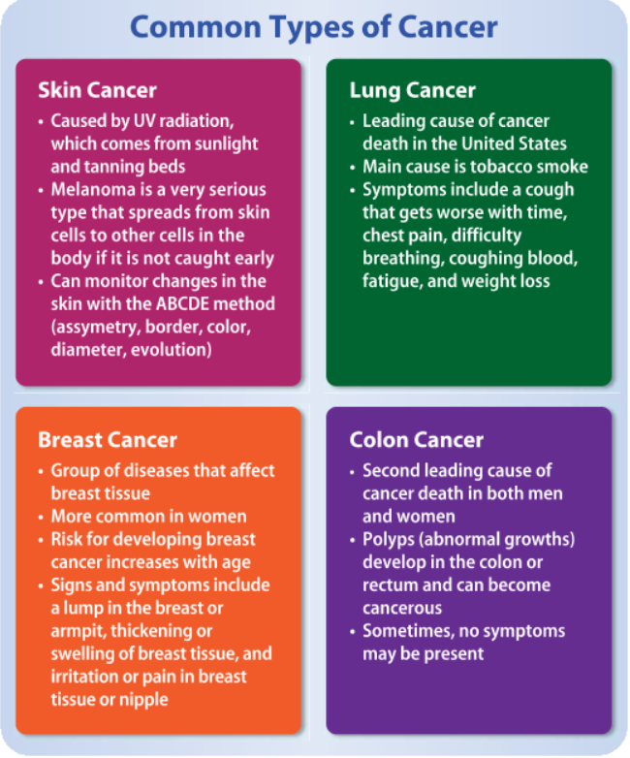

Slide 63
Possible Cancer Signs

Slide 64
Common Noncommunicable Diseases
Chronic respiratory diseases
Chronic obstructive pulmonary disease (COPD), which includes emphysema, chronic bronchitis, and asthma
Respiratory allergies, typically associated with pollen, animal dander, and dust
(continued)

Slide 65
Asthma

Slide 66
Common Noncommunicable Diseases
Diabetes mellitus- Disease resulting from the body’s inability to regulate glucose; commonly known as diabetes
Type 1 involves the pancreas being unable to produce insulin
Type 2 involves the body’s inability to respond appropriately to insulin
Type 1 is typically hereditary while type 2 is associated with obesity
(continued)

Slide 67
Diabetes Symptoms

Slide 68
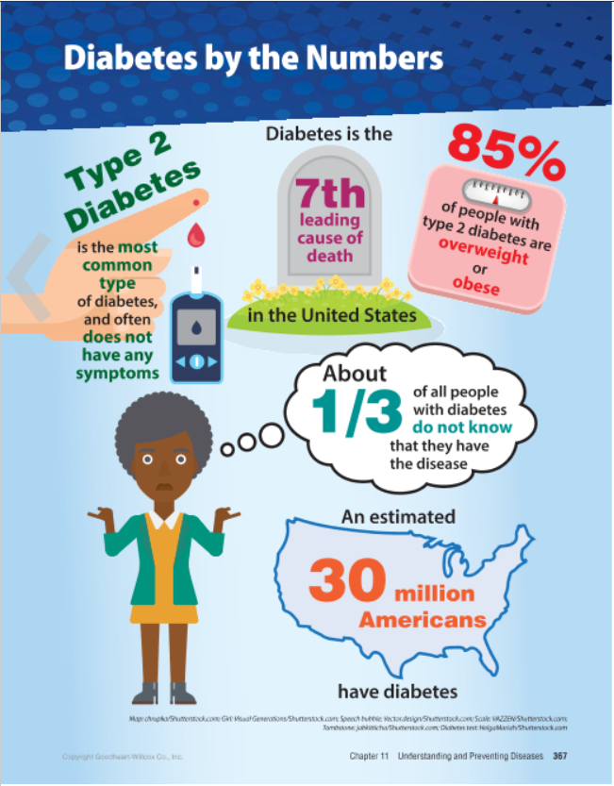
Infographic Discussion
What lifestyle behaviors can increase your risk of type 2 diabetes?

Slide 69
Common Noncommunicable Diseases
Condition that results in inflammation of the joints, causing pain and stiffness is arthritis
Can include osteoarthritis or rheumatoid arthritis, an autoimmune disease- Condition that causes the body’s immune system to attack and damage the joints
Both cause pain, swelling, and stiffness
Can be treated with anti-inflammatory medicines, pain relievers, and mild exercise

Slide 70
Arthritis

Slide 71
Risk Factors

Slide 72
Lesson Review
What is the time without signs and symptoms associated with a disease?
remission
When blood flow to the heart stops and the heart cannot get enough oxygen, a person will experience a _____.
heart attack

Slide 73
11.5
Preventing Diseases

Slide 74
Learning Outcomes
After studying this lesson, you will be able to
demonstrate proper hand washing to prevent communicable diseases.
describe respiratory etiquette practices to prevent communicable diseases.
(continued)

Slide 75
Learning Outcomes
After studying this lesson, you will be able to
give examples of food sanitation practices that maintain the safety of food you handle and eat.
(continued)

Slide 76
Learning Outcomes
After studying this lesson, you will be able to
explain the purpose of vaccines in disease prevention.
summarize how to reduce your risk of noncommunicable diseases.

Slide 77
Preventing Communicable Diseases
Hand washing is important to prevent the spread of communicable diseases
When should you wash your hands?
(continued)

Slide 78
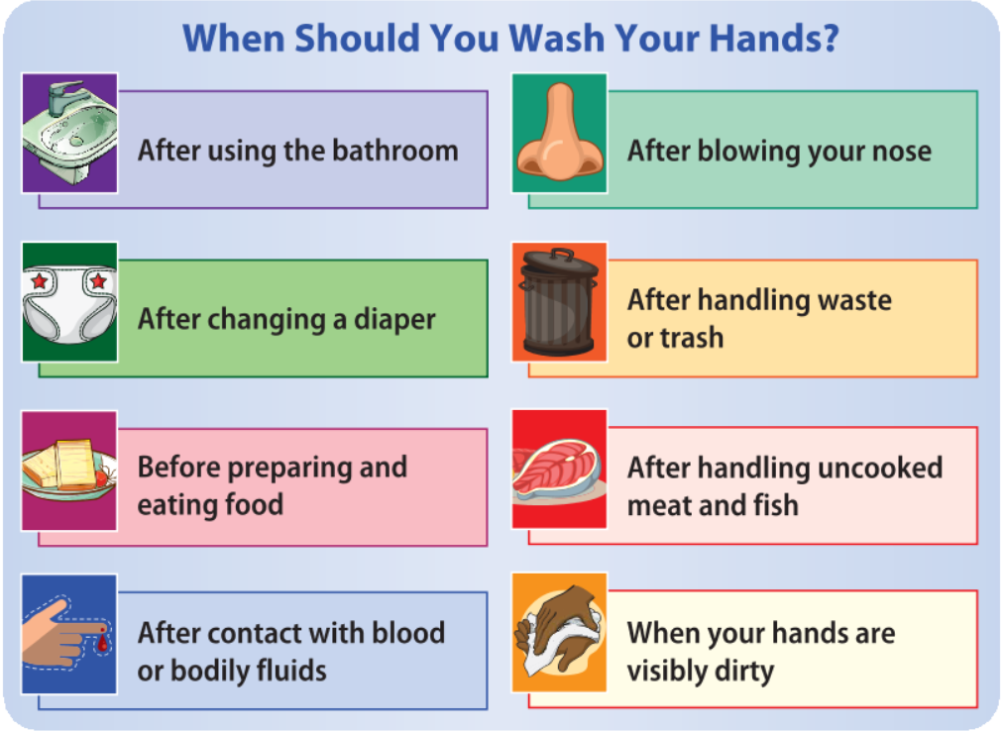
Hand Washing

Slide 79
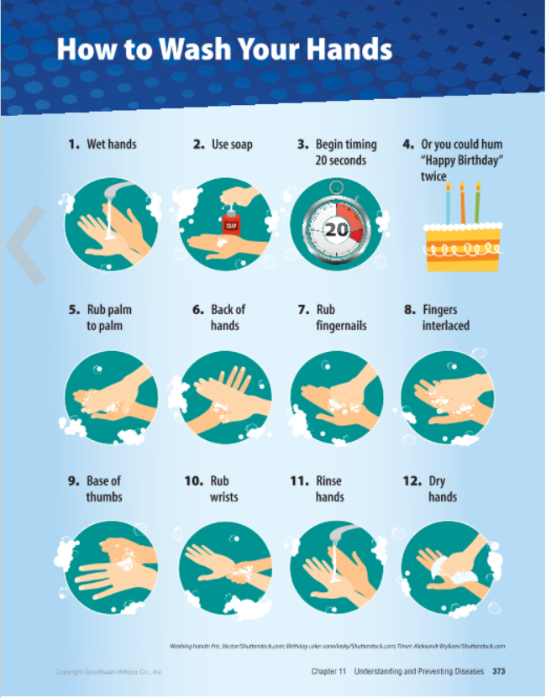
Infographic Discussion
Why is it so important to properly wash your hands?

Slide 80
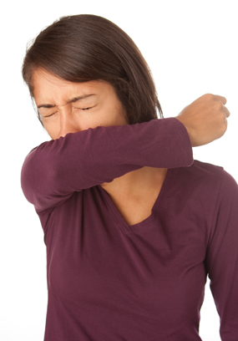
Skills Check
Respiratory etiquette- The practice of covering your mouth and nose with a tissue while coughing or sneezing, or sneezing into your sleeve
Cover your mouth and nose with a tissue when you sneeze or cough Do not reuse or store the tissue If you have no tissues, cough or sneeze into your upper arm or sleeve Wash your hands after sneezing or coughing into your hands
iStock.com/sebarnes

Slide 81
Preventing Communicable Diseases
Pathogens can be transmitted through contaminated food, water, and surfaces
Food safety practices that maintain the safety of the food you handle and eat; includes refrigerating and freezing certain foods, cooking meat thoroughly, and washing vegetables and fruits is called food sanitation
Includes refrigerating and freezing certain foods, cooking meats thoroughly, and washing vegetables and fruits
(continued)

Slide 82
Food Safety

Slide 83
Preventing Communicable Diseases
The only proven method of getting rid of an infectious disease from society is a vaccine- Substance that contains a dead or nontoxic part of the pathogen that is injected into a person to train his or her immune system to eliminate the live pathogen
Safe and effective method

Slide 84
Preventing Noncommunicable Diseases
Making healthy lifestyle choices can help prevent noncommunicable diseases
Get regular physical exercise
Eat more fruits and vegetables and fewer processed foods
Maintain a healthy body weight
Avoid tobacco smoke and other environmental pollutants

Slide 85
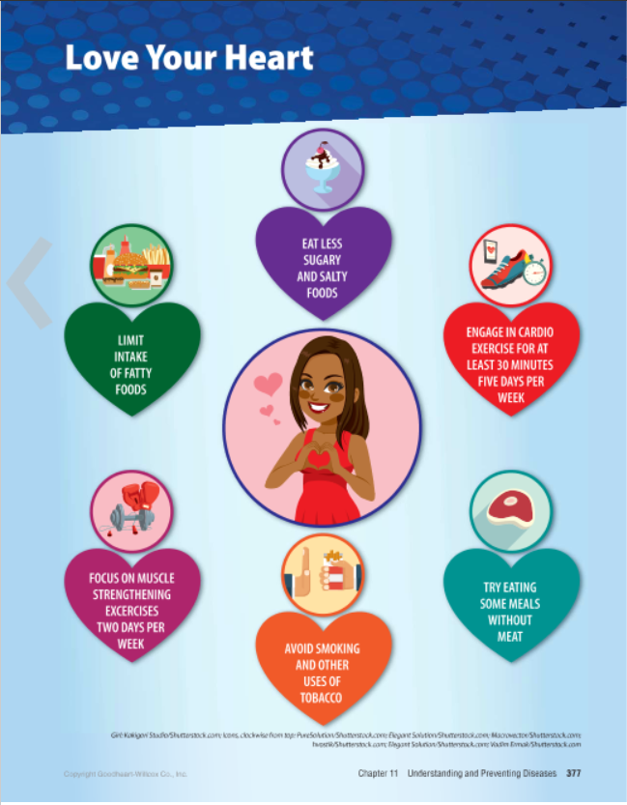
Infographic Discussion
Do you take good care of your heart?
What could you do to love your heart better?

Slide 86
Preventing Noncommunicable Diseases

Slide 87
Lesson Review
How long should you wash your hands?
at least 20 seconds
What should you do if you do not have a tissue to sneeze into?
use your sleeve, upper arm, or elbow
A method of training an immune system to eliminate a pathogen is a(n) _____.
vaccine

