Slide 2
10
Medications and Drugs

Slide 3
10

Slide 4
Essential Question
How do your decisions about drugs and medications relate to your health?

Slide 5
10.1
Medications

Slide 6
Learning Outcomes
After studying this lesson, you will be able to
differentiate between over-the-counter and prescription medications.
explain three health risks of taking medications.
identify strategies for using medications safely.
(continued)

Slide 7
Learning Outcomes
After studying this lesson, you will be able to
summarize the different functions of different types of prescription medications.
differentiate between medication misuse and abuse.

Slide 8
Defining Medications and Drugs
Medications are drugs and medicines used to treat symptoms of an illness or to cure, manage, or prevent a disease
Drugs are medications and other substances that change the way the body or brain functions
(continued)

Slide 9
Defining Medications and Drugs
Not all drugs are medications
Medications include legal drugs- Medications that can treat health conditions to improve a person’s health and enhance wellness
Illegal drugs are not medications and can be harmful to a person’s health
Drugs
Medications
(continued)

Slide 10
Defining Medications and Drugs
There are two types of medications
Over-the-counter (OTC) medications- Medicines people can purchase without a doctor’s written order or prescription to treat the symptoms of many minor health conditions
Prescription medications- Medicines that people can only purchase with a doctor’s written order for the treatment of a specific illness or condition

Slide 11
Defining Medications and Drugs

Slide 12
Health Risks of Taking Medications
All medications can cause side effects- Unpleasant and unwanted symptom that occurs from taking a medication
More likely to occur when starting or stopping use of a medication, or when changing the dose
Common side effects:
Drowsiness
Headache
Nausea
Suicidal thoughts
Abnormal heart rhythm
(continued)

Slide 13
Health Risks of Taking Medications
Some drugs cause health risks by interacting with
other drugs and medications
dietary supplements
foods or drinks (including alcohol)
People may also have allergic reactions to certain medicines

Slide 14
Skills Check
Strategies for using medications safely
Carefully read and follow usage instructions
Check the expiration date on medications before use
Never use a medication prescribed for someone else
Never take more than the recommended dosage of a medication; this can lead to an overdose- Taking too much of a medication; often causes dangerous, life threatening consequences
Store medications in a dry, cool area
Do not give OTC medications intended for adults to children or infants

Slide 15
Skills Check

Slide 16
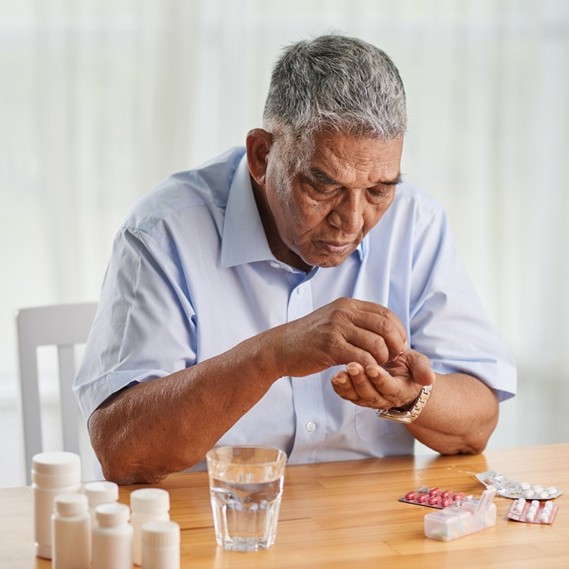
Medication Misuse
Taking medication in a way that does not follow the medication’s instructions; often unintentional, is medication misuse
This can be unintentional, such as forgetting or misunderstanding the instructions
Dragon Images/Shutterstock.com

Slide 17
Medication Abuse
Intentionally taking a drug in a way other than its intended use is medication abuse
Includes taking a higher dosage than recommended or not taking the full prescription
Taking someone else’s prescription is against the law

Slide 18
Medication Abuse

Slide 19
Lesson Review
Which type of medication can be purchased without a prescription?
over-the-counter (OTC) medications
What are the unpleasant symptoms that can occur from taking a medication?
side effects

Slide 20
Lesson Review
What is the term for when a person takes too much of a medication?
overdose
True or false? Medication abuse can be unintentional.
false

Slide 21
10.2
Illegal Drugs

Slide 22
Learning Outcomes
After studying this lesson, you will be able to
give examples of common types of illegal drugs.
describe the short- and long-term health effects of illegal drugs.
explain why some young people use drugs.
(continued)

Slide 23
Learning Outcomes
After studying this lesson, you will be able to
describe the physical, mental, emotional, and social consequences of drug abuse and addiction.
recognize the signs of drug abuse and drug addiction.

Slide 24
Illegal Drugs
Some substances are against the law to use because they can be harmful to a person’s health
These substances are illegal drugs
They can be very dangerous to all aspects of a person’s health

Slide 25
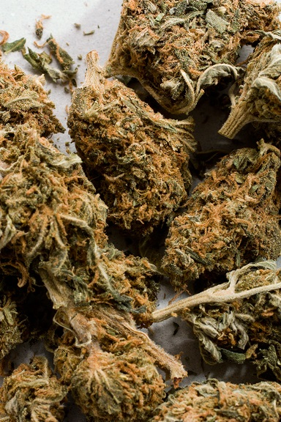
Marijuana
A drug made from the dried parts of the cannabis plant is called marijuana
The active ingredient is a mind-altering chemical called THC
Sometimes manufactured to have up to four times the concentration of THC
(continued)
Courtesy of the Department of Justice, Drug Enforcement Administration

Slide 26
Marijuana
Negative consequences affect physical, mental, social, and emotional health
Difficulty thinking and problem solving
Anxiety and panic attacks
Loss of coordination
Respiratory problems associated with smoking
Problems with memory and learning
(continued)

Slide 27
Marijuana
Legalization of marijuana
A number of states allow the use of marijuana for medical purposes with a doctor’s prescription
A few states now allow nonmedical use of marijuana
Some states, and the federal government, still classify marijuana as an illegal drug

Slide 28
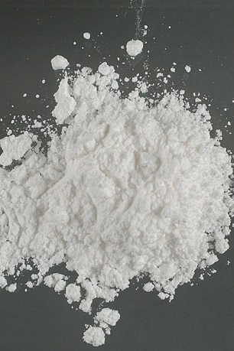
Cocaine
An addictive drug that usually
comes in the form of white
powder made from the leaves
of the coca a plant is cocaine
Intense high that fades quickly and makes the user feel nervous and depressed
Can cause high blood pressure, nausea, headaches, paranoia, and loss of the sense of smell
Courtesy of the Department of Justice, Drug Enforcement Administration

Slide 29
Methamphetamine
A manmade stimulant that speeds up brain function is methamphetamine
Very powerful and extremely addictive
Users experience
Irregular heartbeats
Blurred vision
Dizziness
Violent behavior
Mood swings
Memory loss
Paranoia

Slide 30
Methamphetamine(side effects)

Slide 31
Hallucinogens
Drugs that alter the way people view, think, and feel about things, causing hallucinations are hallucinogens
Short-term health effects include hallucinations, insomnia, panic attacks, and paranoia
Long-term effects include memory loss, difficulty with speech, and seizures

Slide 32
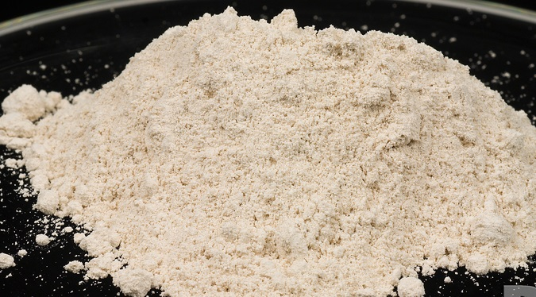
Opioids (Heroin)
Heroin- Drug similar
to painkillers that has
dangerous side effects and is very addictive
is an opioid made from morphine, a substance that comes from the opium poppy plant
Nearly 80 percent of people using heroin abused prescription opioids like morphine first
(continued)
Courtesy of the Department of Justice, Drug Enforcement Administration

Slide 33
Opioids (Heroin)
Short-term health effects
Long-term health effects
Dry mouth
Flushed skin
Problems thinking
Liver disease
Kidney disease
Lung problems
Heart problems
Stomach cramping
Craving for the drug
Death, by overdose
Users feel an intense “high” that quickly wears off

Slide 34
Club Drugs
The term club drugs refers to several types of drugs that young people may abuse at parties, bars, and concerts
These often have no smell or taste, such as date rape drugs
Club drugs have many short-term and long-term health effects

Slide 35
Club Drugs

Slide 36
Anabolic Steroids
Anabolic steroids are artificial hormones
Some imitate testosterone, which helps build muscle
Doctors can prescribe steroids to treat hormonal issues or muscle disorders
Some people use them illegally to increase muscle size
(continued)

Slide 37
Anabolic Steroids
Health effects include
For men
Shrinking of testicles
Baldness
For women
Growth of facial hair
Baldness
For both
Violence
Delusions
Deepened voice
Development of breasts
Liver damage
Kidney failure
Heart attack

Slide 38
Inhalants
Chemicals that people breathe in to experience some type of high are inhalants
Damages the body’s brain cells
Side effects include slurred speech, memory loss, lack of coordination, muscle spasms, dizziness, and hallucinations
Long-term consequences include hearing loss, brain damage, and heart failure

Slide 39
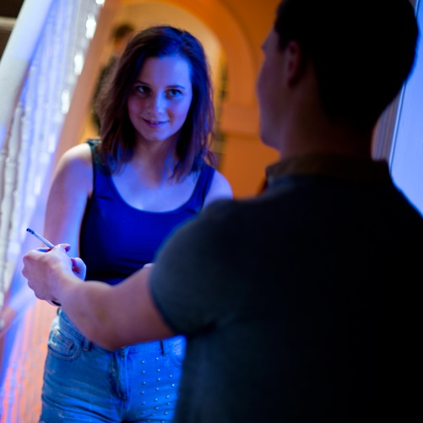
Think About It…
With all of the negative health effects, why do some young people still use illegal drugs?
iStock.com/sturti

Slide 40
Influences on Drug Use
A young person may copy the behavior of a family member, friend, peer group, or role model
Young people may have an incorrect picture of how drugs will affect them and their lives

Slide 41
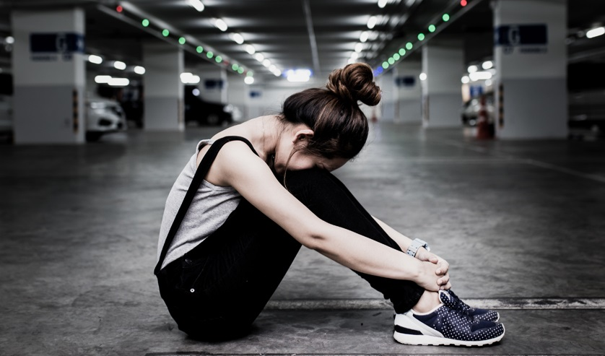
Health Alert!
People with mental health conditions may attempt to treat them through drug use, but drugs can increase feelings of despair, sadness, and exhaustion.
NARONGRIT LOKOOLPRAKIT/Shutterstock.com

Slide 42
Health Alert!

Slide 43
Drug Abuse
Drug abuse is the continued use of a drug despite negative or harmful outcomes
People who abuse drugs are more likely to engage in other risky, unsafe behaviors
Drug abuse can lead to legal, academic, work, financial, and social problems

Slide 44
Infographic Discussion
How can drug use negatively impact a young person’s life long-term?

Slide 45
Drug Addiction
When a person is completely dependent on a drug, this is drug addiction (Complete dependence on a drug)
This person has a physical and psychological need for the drug
No one plans to become addicted, but it often follows experimentation of drugs
Addiction is a disease that needs professional treatment

Slide 46
Lesson Review
Which illegal drug comes from the leaves of the coca plant?
cocaine
The type of drug that can cause hallucinations is called _____.
hallucinogens
(continued)

Slide 47
Lesson Review
Which type of drug is often substances found in the home?
inhalants
True or false? Drug use can negatively impact a young person’s legal, academic, social, and financial life.
true

Slide 48
10.3
Preventing and Treating Drug Abuse and Addiction

Slide 49
Learning Outcomes
After studying this lesson, you will be able to
explain strategies for preventing drug abuse and addiction.
demonstrate refusal skills to resist peer pressure to use drugs.
(continued)

Slide 50
Learning Outcomes
After studying this lesson, you will be able to
describe several treatment methods for drug abuse and addiction.
explain how you can help someone who is addicted to drugs.

Slide 51
Preventing Drug Abuse and Addiction
People who never try drugs cannot abuse them or become addicted to them
Educating young people about the hazards of drug use can help prevent drug abuse and addiction
Many schools have established substance-abuse prevention programs
(continued)

Slide 52
Preventing Drug Abuse and Addiction
Government programs
Public service announcements (PSA)- (Message that is shown in the media to support public health) on TV, in movie previews, or online
An awareness and education program called the AWARxE Prescription Drug Safety Program- Organization that spreads awareness of the growing prescription drug abuse problem
Advertising campaigns targeted to young people

Slide 53
Infographic Discussion
Why do you think prescription medication abuse is growing among young people?

Slide 54
Strategies for Refusing Drugs
Refusal skills can help you stand up to unhealthy and unsafe pressures and influences
Be direct and firm, but polite
Any real friend or nice person will respect your decision

Slide 55
Treating Drug Abuse and Addiction
Often a combination of medicinal and behavioral treatment is used
Medications can help lessen withdrawal symptoms
Behavioral treatment teaches people how to live without drugs, handle cravings, avoid triggers, and prevent or respond to relapses- Occurrence when a person takes a drug again after deciding to stop

Slide 56
Treating Drug Abuse and Addiction
Different rehabilitation programs (Treatment for drug addiction that may involve detoxification, medications, or time spent in a rehabilitation facility) can help treat drug abuse and addiction
Residential treatment program
Outpatient treatment program
Skills-training program
Sober living communities
Support groups

Slide 57
Treating Drug Abuse and Addiction
Residential treatment program- Plan for helping people get through the early stages of breaking an addiction in an inpatient environment with lots of support and few distractions
Outpatient treatment program- Provides drug education or counseling without requiring a hospital stay
Skills-training program- Plan that teaches people skills for dealing with peer pressure and for handling stressful life events without relying on drugs
Sober living communities- Alcohol -and drug- free living environments that reduce some of the temptation and pressure people may feel to use alcohol and drugs

Slide 58
Helping Someone Who Is Addicted to Drugs
Talk to an adult for advice and guidance
Know the possible warning signs that someone may be using drugs
Express your concern and willingness to help
You may need to wait for this person to be ready for help

Slide 59
Skills Check
Know the warning signs that someone may be using drugs
Warning signs
Loss of interest in school
Change in mood or personality
Trouble concentrating in class
Change in sleeping and eating habits
Making new friends who use drugs
Stealing money or selling belongings to get money for drugs

Slide 60
Lesson Review
What is the name of the government program that raises awareness of prescription drug abuse?
AWARxE Prescription Drug Safety Program
True or false? If a person relapses after quitting drug use, they cannot recover.
false

