Slide 2
9
Alcohol

Slide 3
9

Slide 4
Essential Question
What are some health risks of underage drinking?

Slide 5
9.1
The Effects of Alcohol

Slide 6
Learning Outcomes
After studying this lesson, you will be able to
differentiate moderate drinking, binge drinking, and heavy drinking.
analyze the effects of alcohol on the brain.
relate alcohol use to long-term health consequences.
(continued)

Slide 7
Learning Outcomes
After studying this lesson, you will be able to
explain the consequences of underage drinking.
assess the role of alcohol in accidents and violence.
summarize how alcohol use can increase the risk of developing alcohol-use disorders.

Slide 8
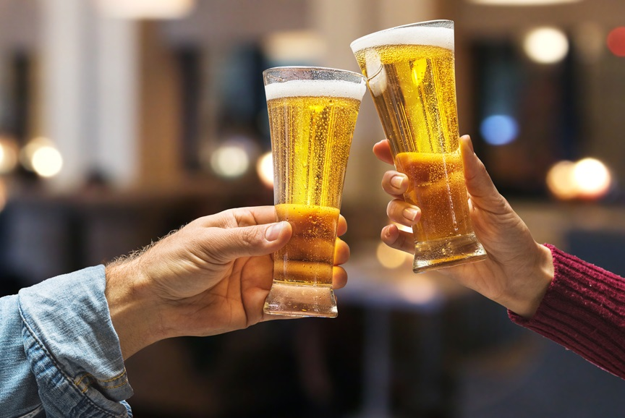
Alcohol Use
Alcohol- Type of drug (known as a depressant) found in drinks- such as beer, wine, and liquor-that can cause a person to
act and feel differently
This is an addictive substance that can have many harmful effects on the user
Valentyn Volkov/Shutterstock.com

Slide 9
Alcohol Use

Slide 10
Health Alert!
The following people should not drink alcohol:
People under the age of 21
Women who are pregnant
People who are driving or operating equipment
People taking certain medications
People with alcohol-use disorders

Slide 11
Alcohol Use
Moderate drinking- Consuming no more than one drink per day for women and no more than two drinks per day for men; also called social drinking
Women: no more than one drink on the same occasion
Men: no more than two drinks on the same occasion
Binge drinking- Consuming four drinks for women and five drinks for men on the same occasion
Women: four or more drinks on the same occasion
Men: five or more drinks on the same occasion
Heavy drinking- Consuming eight or more drinks for women and 15 or more drinks for men in one week; can lead to alcohol dependence
Women: 8 or more drinks in one week
Men: 15 or more drinks in one week

Slide 12
Alcohol Use

Slide 13
Health Effects of Alcohol Use
The percentage of alcohol that is in a person’s blood is the blood alcohol concentration (BAC)
A person who is intoxicated shows substantial physical and mental impairments
(continued)

Slide 14
Health Alert!
Factors that impact how alcohol affects you include
Ethnicity
Gender
Body weight
Food consumption
How fast you drink
How much you drink

Slide 15
Health Effects of Alcohol Use
Side effects of alcohol use on the central nervous system include
difficulty concentrating and memory loss
reduced inhibition- Self-control that keeps people from taking dangerous risks
drowsiness and slowed response rate
impaired vision and loss of balance
(continued)

Slide 16
Health Effects of Alcohol Use

Slide 17
Health Effects of Alcohol Use
Alcohol poisoning
Loss of consciousness
Difficulty breathing
Hangover
Headache
Nausea
Dizziness
Sensitivity to light and sound
Anxiety and depression
Permanent brain damage
Death
Low blood pressure and body temperature
(continued)

Slide 18
Health Alert!

Slide 19
Health Effects of Alcohol Use
Long-term health effects
Dementia
Stroke
Memory problems
Drowsiness
High blood pressure
Heart disease
Cancer
Cirrhosis
Fetal alcohol spectrum disorder

Slide 20
Health Effects of Alcohol Use

Slide 21
Infographic Discussion
Which of these consequences have long-term impacts on a young person’s life?

Slide 22
Alcohol Use and Accidents
Impaired coordination and judgment cause falls, burns, and other injuries
Driving under the influence of alcohol is illegal and dangerous
Many states use a zero-tolerance policy
(Rule that results in punishment of young people caught driving with any level of alcohol in their system) to punish people under 21 years of age who use alcohol

Slide 23
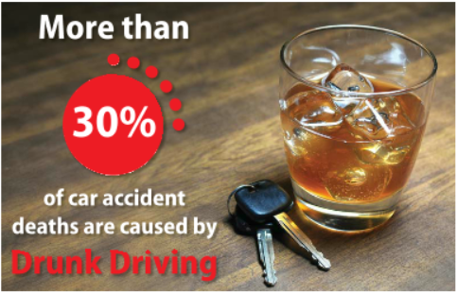
Health Alert!

Slide 24
Alcohol-Use Disorders
Alcohol-use disorders- Conditions that occur when the recurrent use of alcohol causes problems that interfere with a person’s health and responsibilities at school, home, or work
(continued)

Slide 25
Alcohol-Use Disorders
The stages of addiction are
experimentation
tolerance
regular use
dependence
(continued)

Slide 26
Alcohol-Use Disorders

Slide 27
Alcohol-Use Disorders
People with alcohol addiction show a number of symptoms, including
a strong craving for alcohol
an inability to limit their drinking
memory loss or blackouts
continued use of alcohol despite serious problems with their health

Slide 28
Lesson Review
Heavy drinking can lead a person to become dependent on alcohol. How many drinks is considered heavy drinking?
8 or more per week for women; 15 or more per week for men
The self-control that keeps people from taking dangerous risks is called _____.
inhibition

Slide 29
9.2
Preventing and Treating Alcohol-Use Disorders

Slide 30
Learning Outcomes
After studying this lesson, you will be able to
describe factors that influence young people’s beliefs about alcohol use.
demonstrate methods of preventing alcohol-use disorders.
(continued)

Slide 31
Learning Outcomes
After studying this lesson, you will be able to
explain treatment methods for alcohol-use disorders.
demonstrate how to help someone who has an alcohol-use disorder.

Slide 32
Factors That Influence Beliefs About Alcohol Use
The people in a young person’s life can influence their beliefs about alcohol use
This can be positive or negative
If important people in a young person’s life model unhealthy behaviors, he or she is more likely to engage in that behavior

Slide 33
Think About It…
Who in your life influences the way you think about alcohol use?
Hilch/Shutterstock.com

Slide 34
Health Alert!

Slide 35
Infographic Discussion
Which of these influences do you think has the strongest impact on a young person’s decisions about alcohol?

Slide 36
Skills Check
Make IDEAL decisions for your health
Identify the situation or problem
Describe all the possible solutions
Evaluate all those solutions
Act on the best solution
Learn from the experience

Slide 37
Preventing Alcohol-Use Disorders
Education and refusal skills
School programs provide information about the consequences of alcohol use
These disprove the belief that alcohol use is the norm among young people
Refusal skills help when offered alcohol
(continued)

Slide 38
Skills Check
Strategies for refusing alcohol
Be clear and firm, yet respectful
Practice your response ahead of time
No thanks!
Drinking makes me feel sick.
I don’t drink, but thank you!
Drinking isn’t fun for me.

Slide 39
Preventing Alcohol-Use Disorders
Government approaches
Setting the legal drinking age at 21
Restricting access to alcohol in grocery and convenience stores
Raising the price of alcohol through taxes
Creating advertisements for drinking prevention
21

Slide 40
Preventing Alcohol-Use Disorders

Slide 41
Treating Alcohol-Use Disorders

Slide 42
Treating Alcohol-Use Disorders
Process of completely stopping all alcohol use to remove the substance from the body is called detoxification
May take up to a month
Can include severe withdrawal symptoms like anxiety, tremors, and hallucinations
(continued)

Slide 43
Treating Alcohol-Use Disorders
Support groups bring people together who can share advice on getting through a common struggle
Alcoholics Anonymous- (Self-help program for people with alcohol-use disorders to help them change how they think about drinking) includes a support group element
People who have family members with alcohol-use disorders can use Alateen- Support group where young people who have loved ones with an alcohol-use disorder come together to share their experiences and learn ways to cope with problems and Al-Anon Family Groups- Support group where family members and friends who have loved ones with an alcohol-use disorder come together to share their experiences, receive encouragement, and learn ways to cope with problems

Slide 44
Skills Check
Self-management strategies
Understanding the motivations that lead to drinking
Avoiding situations where alcohol is present
Responding in new ways to the presence of alcohol
Learning new strategies for handling stress
Developing refusal skills for alcohol use

Slide 45
Helping a Loved One with an Alcohol-Use Disorder
How to help
Recognize that you cannot force or bribe this person to get help
Hiding their alcohol use is only enabling- (Encouraging a person’s unhealthy behaviors, either intentionally or unintentionally) their unhealthy behaviors to continue
Speak to a trusted adult about your loved one

Slide 46
Lesson Review
True or false? Seeing characters drink alcohol on TV or in movies can influence young people to drink.
true
The process of completely stopping alcohol use to remove the substance from your body is called _____.
detoxification

