Slide 2
8
Tobacco

Slide 3
8

Slide 4
Essential Question
How is tobacco hazardous to the human body?

Slide 5
8.1
Tobacco and Your Health

Slide 6
Learning Outcomes
After studying this lesson, you will be able to
identify various forms of tobacco and the addictive substance in tobacco products.
assess the hazardous effects of tobacco use on heart and lungs.
(continued)

Slide 7
Learning Outcomes
After studying this lesson, you will be able to
describe how tobacco use can affect a person’s appearance.
explain the impact of secondhand smoke on individuals.

Slide 8
Tobacco
Tobacco- Plant used
to create tobacco
related-products, such as cigarettes and
chewing tobacco
Nicotine- Toxic chemical in tobacco leaves that makes tobacco products addictive- Habit-forming
nnattalli/Shutterstock.com

Slide 9
Tobacco-Related Products
Cigarettes
Cigars
Pipes
ENDS
Snuff
5 second Studio/Shutterstock.com; marco mayer/Shutterstock.com; gresei/Shutterstock.com; bildfokus.se/Shutterstock.com; LezinAV/Shutterstock.com

Slide 10
Health Alert!
Cigarettes contain over 7,000 chemicals, including the following:
acetone (found in nail polish remover)
arsenic (used in rat poison)
methanol (component in rocket fuel)
tar (material for paving roads)

Slide 11
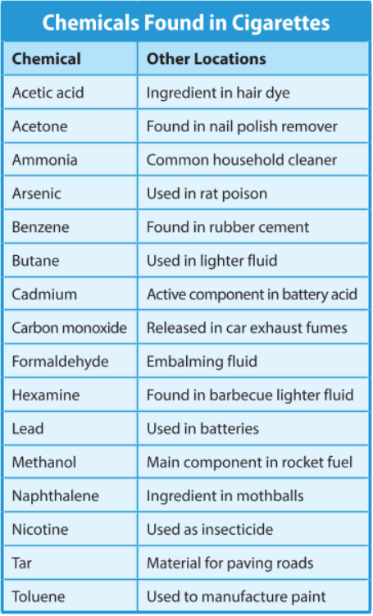

Slide 12
Health Hazards of Tobacco Use
Smoking is the leading cause of preventable death in the United States

Slide 13
Hazards by Method
Smoking (cigarettes, cigars, pipes)
produces tar, contains toxic- Poisonous- substances
Smokeless tobacco
contains carcinogens- Cancer-causing agents- which are absorbed through the mouth
Electronic nicotine delivery system
converts nicotine into vapor

Slide 14
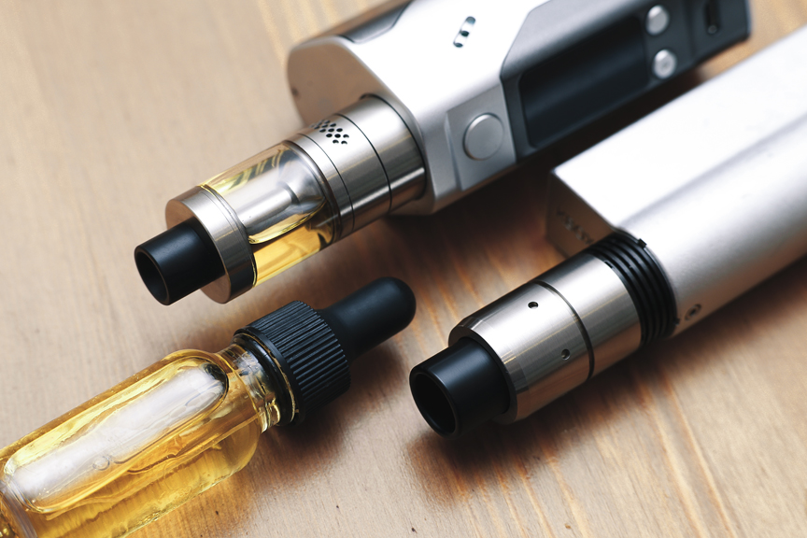
Think About It…
If ENDS do not use any actual tobacco, are they still toxic?
LezinAV/Shutterstock.com

Slide 15
Health Effects of Tobacco Use
High blood pressure
Heart disease
Lung cancer
Asthma
Emphysema
Chronic bronchitis

Slide 16
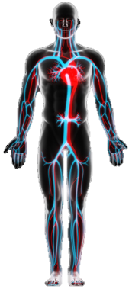
Tobacco Use and the Circulatory System
Nicotine increases heart rate and blood pressure
Nicotine causes blood vessels to constrict and allows fatty substances to build up in the arteries, disrupting blood flow
(continued)
CLIPAREA | Custom media/Shutterstock.com

Slide 17
Tobacco Use and the Circulatory System
Over time, stress on the heart makes heart disease more likely
The buildup of fatty substances increases the risk of a heart attack or stroke
CLIPAREA | Custom media/Shutterstock.com

Slide 18
Tobacco Use and the Circulatory System
Video

Slide 19
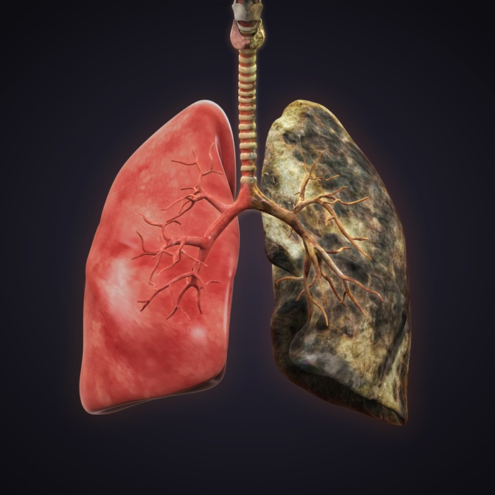
Tobacco Use and the Lungs
Burning tobacco produces a residue known as tar- Residue produced by burning tobacco; consists of a small, thick, sticky particles , which builds up in the lungs and damages them
iStock.com/Nerthuz

Slide 20
Chronic Respiratory Diseases
Smoking can irritate and swell the bronchioles
Makes breathing more difficult
Known as chronic bronchitis- ongoing condition in which small tubes in the lungs becomes swollen and irritated
Damage to alveoli causes emphysema- Disease that causes the airways in the lungs to become permanently enlarged
Reduces the amount of oxygen that can enter the lungs and bloodstream

Slide 21
Chronic Respiratory Diseases
Asthma- Chronic disease caused by blockages of airflow two and from the lungs
The irritation of inhaling tobacco smoke, personally or secondhand, can cause an asthma attack

Slide 22
Infographic Discussion
With so many increased health risks, including cancer, why do you think people still choose to smoke?

Slide 23
Effects of Tobacco on Your Appearance
Yellow stains on teeth and fingers
Gum disease and bad breath
Hair loss
Brittle nails
Sagging or wrinkled skin
Clothes and hair that smell of smoke

Slide 24
Secondhand Smoke
Secondhand smoke- Tobacco smoke released into the environment by smokers, which other people nearby inhale
Even a small amount increases health risks
(continued)
DVARG/Shutterstock.com

Slide 25
Secondhand Smoke
Increases health risks at all ages
Fetuses
Miscarriage
Premature birth
Children
Ear infections
Asthma attacks
Adults
Heart disease
Stroke
Sudden infant death syndrome
Bronchitis
Pneumonia
Lung cancer

Slide 26
Lesson Review
What does ENDS stand for?
electronic nicotine delivery system
Which chronic respiratory disease is caused by damage to the alveoli?
emphysema
True or false? Secondhand smoke increases health risks in people of all ages.
true

Slide 27
8.2
Understanding Tobacco Use

Slide 28
Learning Outcomes
After studying this lesson, you will be able to
summarize the factors that cause teens to try smoking.
analyze the stages of addiction in relation to tobacco use.
(continued)

Slide 29
Learning Outcomes
After studying this lesson, you will be able to
describe two types of dependence.
give examples of withdrawal symptoms people with a nicotine addiction may experience.

Slide 30
Understanding Tobacco Use
Visual Generations/Shutterstock.com

Slide 31
Why Do Young People Experiment with Smoking?
Identity exploration
Association of smoking with maturity, popularity, or glamour
Parents and environments
Influence of parents or family members who smoke
(continued)

Slide 32
Why Do Young People Experiment with Smoking?
Peer pressure- Influence
that people your age
have on your actions
Influence of friends or classmates who smoke, including peer pressure
Media messages
Influence of celebrities who smoke on TV, in movies, or on social media
iStock.com/peepo

Slide 33
Stages of Addiction
Addiction: Physical and psychological need for a substance or behavior
Stage 1 Experimentation
Stage 2 Regular use
Stage 3 Tolerance
Stage 4 Dependence

Slide 34
Experimentation and Regular Use
Young people often first use a substance “just to try it”
Experimentation often leads to the regular use of a substance
Increase use of substance over time

Slide 35
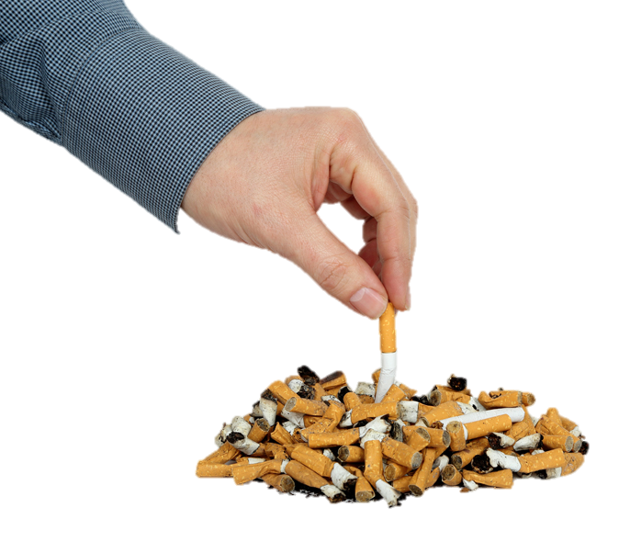
Tolerance to Tobacco
People who regularly use a substance develop a tolerance for that substance
A tolerance is the effect that occurs when the body needs more and more of a substance to experience the desired affects
ConstantinosZ/Shutterstock.com

Slide 36
Tobacco Dependency
Dependence- Effect that occurs when the body needs an addictive substance in its system to function “normally” or feel “normal”
There are two types of dependence: physical and psychological

Slide 37
Physical Dependence
Without an addictive substance, a physically dependent person will experience withdrawal symptoms- Unpleasant symptoms that occur when someone addicted to a substance tries to stop using that substance
Irritability
Difficulty focusing
Nausea
Weight gain
Fatigue

Slide 38
Physical Dependence

Slide 39
Psychological Dependence
For those who are psychologically dependent on a substance, triggers- (Reminders that cause people to feel a strong desire for a substance) - cause people to relate mental or emotional states with that substance

Slide 40
Psychological Dependence

Slide 41
Lesson Review
The influence people your age have on your actions is called _____.
peer pressure
What happens during the tolerance stage of addiction?
a user’s body gets used to a substance
(continued)

Slide 42
Lesson Review
Jacques gets a headache if he does not smoke. Which type of dependence is this?
physical dependence
If someone addicted to a substance tries to stop using the substance, they may experience _____ symptoms.
withdrawal

Slide 43
8.3
Quitting and Preventing Tobacco Use

Slide 44
Learning Outcomes
After studying this lesson, you will be able to
identify steps someone can follow when trying to quit tobacco.
describe treatment methods for nicotine addiction.
(continued)

Slide 45
Learning Outcomes
After studying this lesson, you will be able to
outline effective strategies to prevent and discourage tobacco use.
demonstrate skills for resisting tobacco.

Slide 46
Breaking the Tobacco Habit
Smoking cessation (Quitting smoking) results in several health benefits
Within a few days
Within the first year
After a year or more
Lower blood pressure
Slower heart rate
Less coughing
Decreased risk of heart attack
Decreased risk of cancer
Health benefits continue
Decreased major health issue risk

Slide 47
Useful Steps to Quitting Tobacco Use
1
Attend individual or group counseling
2
Talk to a trusted adult
3
Call a helpline that provides counseling to people trying to quit using tobacco
4
Research online resources that have information on smoking cessation

Slide 48
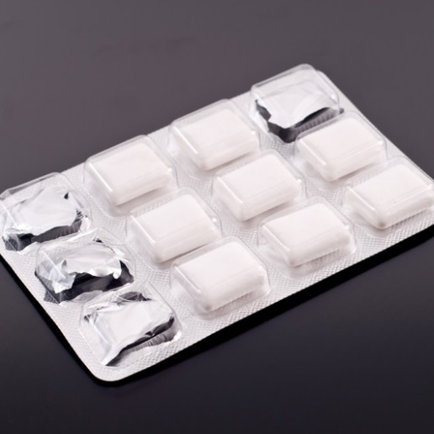
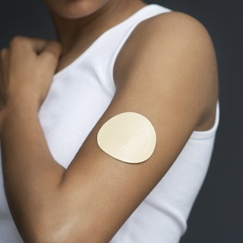
Treatment Methods for Nicotine Addiction
Nicotine replacement- Smoking cessation technique that involves the use of nicotine gum or the nicotine patch to lessen withdrawal symptoms
Nicotine gum or nicotine patch
Self-management strategies
Stimulus control- Smoking cessation technique that involves avoiding tempting situations and managing feelings that lead to nicotine use
Response substitution- Smoking cessation technique that involves responding to difficult feelings and situations with behaviors other than smoking
jcjgphotography/Shutterstock.com; bikeriderlondon/Shutterstock.com

Slide 49
Preventing and Discouraging Tobacco Use
Government strategies
Tobacco product sales restrictions for people under 18 years of age
Graphic warning labels on tobacco product packaging
Ban on smoking in public places
Taxes on cigarettes

Slide 50
Preventing and Discouraging Tobacco Use

Slide 51
Preventing and Discouraging Tobacco Use

Slide 52
Skills Check
Refusal skills for resisting tobacco
Interact with peers who do not smoke
Be clear about your feelings toward smoking
Firmly explain your reasons and stick to your decision
Practice responses for when you are faced with peer pressure

Slide 53
Video

Slide 54
Lesson Review
Which smoking cessation method uses non-tobacco forms of nicotine?
nicotine replacement
What is the minimum age to purchase tobacco products in the United States?
18

