Slide 2
7
Physical Fitness

Slide 3
7

Slide 4
Essential Question
How physically fit are you?

Slide 5
7.1
What It Means to Be Physically Fit

Slide 6
Learning Outcomes
After studying this lesson, you will be able to
define the terms fitness, exercise, and physical activity.
describe the benefits of physical activity.
(continued)

Slide 7
Learning Outcomes
After studying this lesson, you will be able to
summarize the key guidelines for children and teens, adults, and older adults as outlined in the Physical Activity Guidelines for Americans.
evaluate how you can improve your health by doing activities you enjoy.

Slide 8
Defining Fitness
Fitness refers to the body’s ability to meet daily physical demands
You can become physically fit through
planned, structured, and purposeful physical activities, called exercise
other physical activities- Broad term that describes structured exercise as well as other activities that use energy

Slide 9
Infographic Discussion
Which aspects of health are improved by physical activity?

Slide 10
Health Alert!
Despite the benefits of physical activity, many people still live sedentary (inactive) lifestyles
Sedentary activities include watching TV or movies, playing video games, using social media, or reading
Monkey Business Images/Shutterstock.com

Slide 11
Physical Activity Guidelines
The Physical Activity Guidelines for Americans- Resource health professionals use to provide guidance on how people can improve their health through physical activities
Children and teens
60 minutes per day
Adults
150 minutes per week
Older adults
As much as their abilities allow

Slide 12
Fitness and Technology

Slide 13
Skills Check
Choose physical activities you enjoy
Do you prefer sports or unstructured physical activity?
Do you like to exercise by yourself or with friends?
Do you prefer indoor or outdoor activities?

Slide 14
Lesson Review
True or false? All physical activity is exercise.
false
People who spend much of their day doing activities that involve sitting and using very little energy are being _____.
sedentary

Slide 15
Lesson Review
Jericho is 12 years old. According to the Physical Activity Guidelines for Americans, how much physical activity should he get, and how often?
60 minutes every day

Slide 16
7.2
Fitness Types

Slide 17
Learning Outcomes
After studying this lesson, you will be able to
describe five parts of health-related fitness.
compare and contrast aerobic activities and anaerobic activities.
(continued)

Slide 18
Learning Outcomes
After studying this lesson, you will be able to
explain the two types of endurance.
differentiate between health-related fitness and skill-related fitness.
identify the six aspects of skill-related fitness.

Slide 19
Infographic Discussion
What is the difference between
health-related and skill-related fitness?

Slide 20
Health-Related Fitness
The type of fitness a person needs to perform daily activities with ease and energy is health-related fitness
Heart and lung strength
Muscle strength
Endurance
Body composition
Flexibility
(continued)

Slide 21
Health-Related Fitness
Heart and lung strength
As you perform aerobic exercise- activity involving the use of oxygen to fuel processes in the body, your heart rate and breathing quicken
Muscle strength
Anaerobic exercise- activity involving the use of energy stored in the muscles to supply the body with the fuel it needs to exert force against resistance- opposition
(continued)

Slide 22
Health-Related Fitness
Endurance
The ability to continue an activity over a period of time without tiring
Includes aerobic endurance and muscle endurance
Body composition
Ratio of body fat, bone, and muscle
(continued)

Slide 23
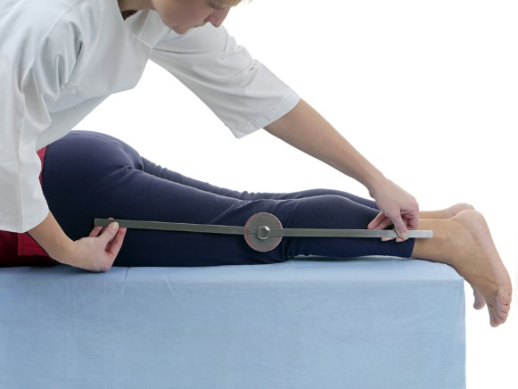
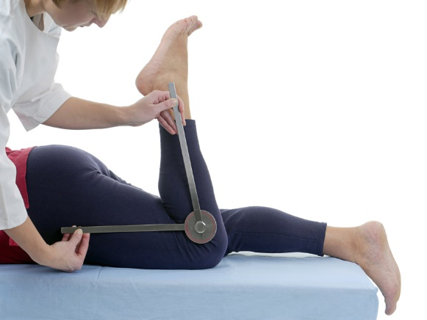
Health-Related Fitness
Flexibility
The ability to fully and easily move muscles and joints
Can improve performance of physical activities
Lowers the risk of injuries
pryzmat/Shutterstock.com

Slide 24
Skill-Related Fitness
Skill-related fitness- Type of fitness that improves a person’s performance in a particular sport
Speed
Agility
Balance
Power
Coordination
Reaction time
(continued)

Slide 25
Skill-Related Fitness
Speed
Moving quickly, which is important in many sports
Agility
Rapidly changing momentum and direction to go under, over, or around obstacles
(continued)
LifetimeStock/Shutterstock.com

Slide 26
Skill-Related Fitness
Balance
Holding a certain body posture or position
Involved in some sports and many leisure activities
Power
A mix of strength and speed
(continued)

Slide 27
Think About It…
A person can be fast, but not strong.
A person can also be strong, but not fast.
Which skill-related fitness involves someone being both strong and fast?

Slide 28
Skill-Related Fitness
Coordination
The ability to perform various movements easily and gracefully
Comes from both natural ability and practice
Reaction time
How quickly a person responds to someone else’s movement

Slide 29
Lesson Review
To perform daily activities with ease and energy, a person needs good _____ fitness.
health-related
Your body uses the energy stored in your muscles during _____ exercise.
anaerobic
(continued)

Slide 30
Lesson Review
Name the two types of endurance.
aerobic endurance and muscle endurance
Speed, power, balance, coordination, agility, and reaction time are all parts of _____ fitness.
skill-related

Slide 31
7.3
Fitness Safety

Slide 32
Learning Outcomes
After studying this lesson, you will be able to
give examples of rules you have learned in sports.
identify common safety equipment for physical activities.
(continued)

Slide 33
Learning Outcomes
After studying this lesson, you will be able to
explain why it is important to start slowly and not overdo it when starting a fitness program.
describe why drinking water is important before, during, and after physical activity.
(continued)

Slide 34
Learning Outcomes
After studying this lesson, you will be able to
list steps you can take to ensure your safety when exercising in hot or cold weather.
compare and contrast a sprain, dislocation, and fracture.

Slide 35
Fitness Safety
You cannot engage in regular physical activity if you are injured
Following accepted guidelines and taking necessary precautions is critical to your health
(continued)
Anothai Thiansawang/Shutterstock.com

Slide 36
Skills Check
Tips for fitness safety
Follow the rules
Use proper safety equipment
Start slowly and do not overdo it
Drink lots of water
Use caution in hot and cold weather
Follow doctor’s instructions for any injuries

Slide 37
Safety Equipment

Slide 38
Fitness Safety
Engaging in physical activity outdoors can be dangerous in certain weather conditions
Heat-related illnesses are hyperthermia- Serious condition that results when the heat regulating mechanisms of the body are unable to deal with the heat from the environment, which results in a very high body temperature
Cold-related illnesses are hypothermia- Serious condition that results when a person’s body loses heat faster than it can produce it, which can include frostbite- Injury caused by the freezing of skin and body tissues

Slide 39
Physical Activity Injuries
Sprain
Dislocation
Fracture
Concussion
Common sports injury involving the stretching or tearing of ligaments (tissues that hold joints) together
Serious injury in which bones move out of their normal position
Broken bone
Type of brain injury that results from a blow or jolt to the head or upper body
Follow the R.I.C.E. treatment
Seek medical treatment right away
Forcing bones into place can cause further injuries
Seek medical treatment right away

Slide 40
Skills Check
The R.I.C.E. Treatment
Rest
Limit movement of the limb to allow recovery and healing
Immobilize
Wrap the injury with an elastic bandage to prevent or reduce swelling
Cold
Cover the injury with a cold compress for 15 minutes several times a day
Elevate
Raise the injury above the heart to control swelling

Slide 41
Lesson Review
True or false? Drinking water is important before, during, and after physical activity.
true
_____ describes cold-related illnesses and _____ describes heat-related illnesses.
Hypothermia; hyperthermia

Slide 42
7.4
A Personal Fitness Plan

Slide 43
Learning Outcomes
After studying this lesson, you will be able to
determine your current level of fitness.
identify your personal fitness goals.
explain what FITT means.
(continued)

Slide 44
Learning Outcomes
After studying this lesson, you will be able to
determine your maximum heart rate and your target heart rates for moderate- and vigorous-intensity activities.
create a tracking report to help you achieve your fitness goals.

Slide 45
Checking Your Health-Related Fitness Level
You can check your current level of health-related fitness by
measuring your aerobic fitness
measuring your muscle strength and endurance
checking your flexibility
determining your body mass index

Slide 46
Skills Check
Checking your health-related fitness
Aerobic fitness
Record your pulse- Person’s heart rate before and after you briskly walk one mile
Muscle strength and endurance
Count how many push-ups you can do at one time
Flexibility
Sit with your legs in front of you and see how far you can reach toward your toes
Body mass index
Measure the circumference of your waist and calculate BMI using the formula

Slide 47
Pulse

Slide 48
Setting Your Fitness Goals
Fitness goals can help you improve
how often you get physical activity
intensity- Measure of how much energy is used during the exercise -of your physical activities
how reliably you stick to your fitness schedule
your participation in group activities

Slide 49
Setting Your Fitness Goals
FITT- Acronym used to focus on the key fitness factors of frequency, intensity, time, and type

Slide 50
Skills Check
Your physical activity should be FITT
Frequency
Children and teens need aerobic activity every day
Intensity
Time
Should add up to at least 60 minutes per day
Type
You can judge by heart rate and breathing
Should have a variety of activities you enjoy

Slide 51
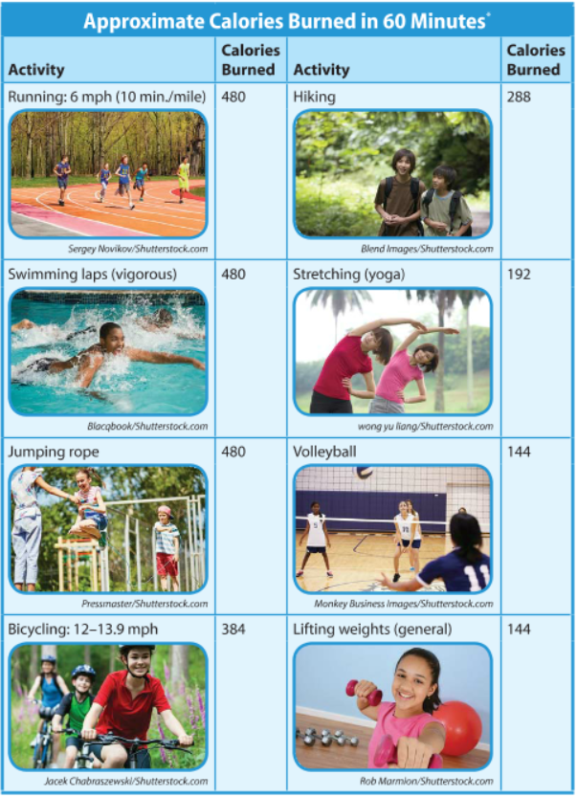

Slide 52
Maximizing Your Workouts
Keep track of your progress
This will ensure that you stay on track with your goals
Revise your plan if the time of day or type of activity does not work for you

Slide 53
Track Your Fitness

Slide 54
Warm-Ups and Cool-Downs
5 to 10 minutes each
Low-intensity aerobic activity, such as jogging or brisk walking
Should include at least 5 minutes of stretching to prevent muscle stiffness and injury
Syda Productions/Shutterstock.com

Slide 55
Maximizing Aerobic Workouts
Perform at moderate- or vigorous-intensity levels
Your target heart rate- Heart rate to aim for while performing aerobic exercise to get the best results from a workout; varies by age -will help you get the best results from your workout
Your maximum heart rate- number of beats per minute a person’s heart can achieve when working its hardest; varies by age

Slide 56
Heart Rate

Slide 57
Maximizing Anaerobic Workouts
Two to three times per week for 20 to 30 minutes
Use proper form and pay attention to your breathing
Do two or three sets- Anaerobic exercises done in groups of repetitions followed by rest , and increase your repetitions as you build muscle endurance

Slide 58
Lesson Review
Juanita wants to check her aerobic fitness. She can do this by recording her _____.
pulse
What does the acronym FITT stand for?
frequency, intensity, time, type

