Slide 2
6
Nutrition

Slide 3
6

Slide 4
Essential Question
How do the foods you eat affect your overall health?

Slide 5
6.1
Getting Enough Nutrients

Slide 6
Learning Outcomes
After studying this lesson, you will be able to
identify the six types of nutrients.
explain the role of each nutrient in the body.
identify sources of each nutrient.
describe the importance of water to good health.

Slide 7
Types of Nutrients
All foods contain nutrients- Chemical substances that give your body what it needs to grow and function properly (video)
Carbohydrates
Protein
Fats
Vitamins
Minerals
Water

Slide 8
Carbohydrates
Carbohydrates- Major source of energy for the body; found in fruits, vegetables, grains, and milk products
Simple carbohydrates are sugars, found in fruits and dairy products
Complex carbohydrates are starches, found in grains, beans, and potatoes
(continued)

Slide 9
Carbohydrates

Slide 10
Carbohydrates
The body is unable to digest fiber-Tough, complex carbohydrate that the body is unable to digest
Dietary fiber
Found in fruits, vegetables, whole grains, nuts
Lowers cholesterol
Balances glucose level
Adds bulk to stools
Helps prevent overeating
Julia Sudnitskaya/Shutterstock.com

Slide 11
Protein
Protein- Nutrient the body uses to build and maintain all of its cells and tissues

Slide 12
Protein
Proteins are made up of amino acids
Your body can only get essential amino acids through the foods you eat
A complete protein contains all nine essential amino acids, and is found mainly in animal-based foods
koss13/Shutterstock.com

Slide 13
Protein

Slide 14
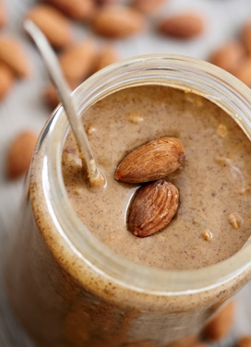
Fats
Fats- Type of nutrient largely made up of fatty acid, which provide a valuable source of energy -particularly for muscles
Your body stores excess dietary fat from the foods you eat as body fat
(continued)
sumikophoto/Shutterstock.com

Slide 15
Fats
Saturated fats
Found primarily in animal-based foods, like meat and dairy products
Unsaturated fats
Found in plant-based foods, such as vegetable oils, peanut butter, margarine, olives, nuts, and seeds
Trans fats
Found in many processed foods, such as packaged cookies, chips, doughnuts, and crackers
Some occur naturally in foods from animals
Typically solid at room temperature
Liquid at room temperature
(continued)

Slide 16
Fats
Some fats are better for you than others
Diets high in saturated fats may lead to health problems such as heart disease and diabetes
Trans fats pose major health risks as well
BW Folsom/Shutterstock.com

Slide 17
Fats

Slide 18
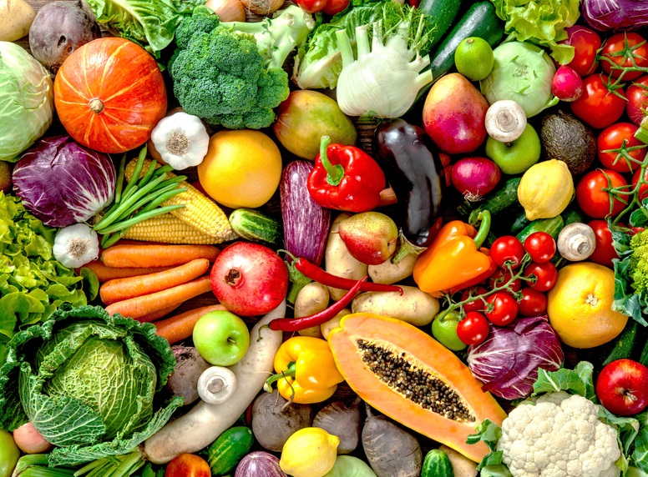
Vitamins
Substances that come from plants or animals that are necessary for normal growth and development are vitamins
Your body requires 13 vitamins from food
Easily provided by a balanced diet with a variety of foods
(continued)
Alexander Raths/Shutterstock.com

Slide 19
Vitamins
Water-soluble vitamins
Used immediately by the body or removed through urination
Vitamin C and the B vitamins
Fat-soluble vitamins
Stored in the body for later use
Vitamins A, D, E, and K
Needed every day
Not needed every day, too much can be bad for the body

Slide 20
Minerals
Minerals- Inorganic elements found in soil and water that the body needs in small quantities, which you absorb from:
the plants you eat
the water you drink
animal food sources that have absorbed minerals
(continued)
Fedoravacz/Shutterstock;com; mimagephotography/Shutterstock.com; Syda Productions/Shutterstock.com

Slide 21
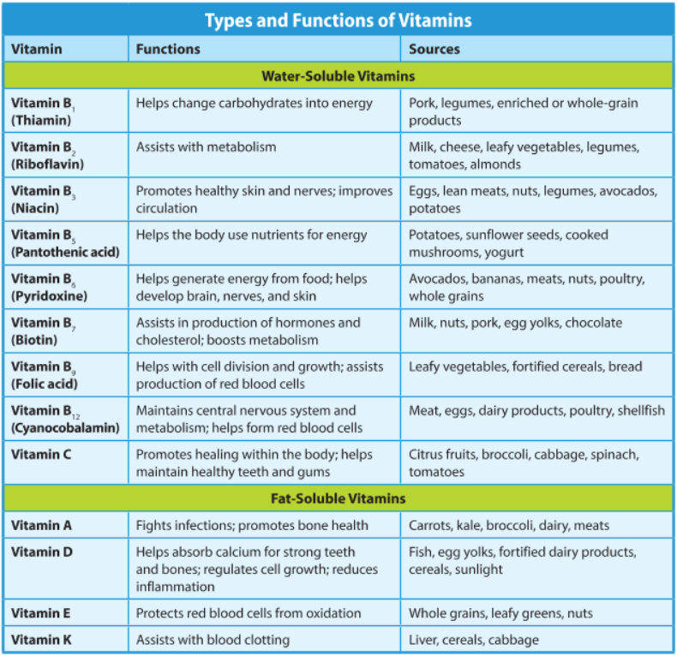

Slide 22
Minerals
Major minerals
Needed in larger quantities
Trace minerals
Needed in smaller quantities
Includes iron, which carries oxygen from the lungs to the tissues
Includes calcium, which promotes bone and muscle health
Also includes magnesium, potassium, and sodium
Also includes fluoride, manganese, and zinc

Slide 23
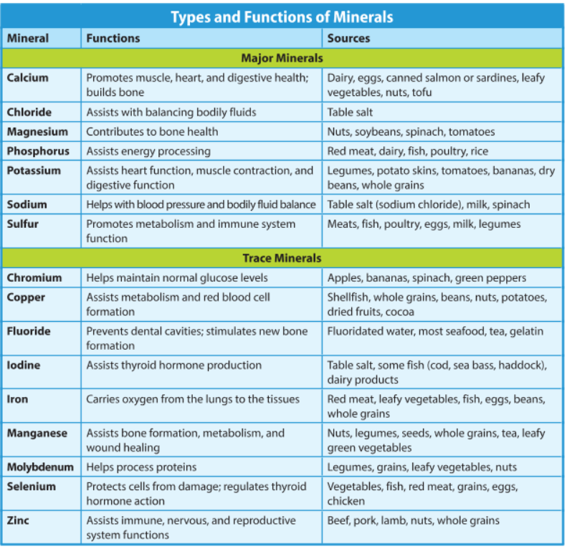

Slide 24
Water
Your body loses water every day through
When the body’s tissues lose too much water, this is called dehydration
urination
sweat
exhaling breath
(continued)

Slide 25
Water
To avoid dehydration, replenish the water your body loses
8½ to 11½ cups of fluids per day

Slide 26
Health Alert!
People can live for several weeks without any other nutrients, but only a few days without water.
Una Shimpraga/Shutterstock.com

Slide 27
Lesson Review
Which type of nutrient provide valuable energy for muscles?
fats
Dietary _____ is a tough complex carbohydrate that the body is unable to digest.
fiber
(continued)

Slide 28
Lesson Review
Proteins with all essential amino acids are found primarily in _____-based foods.
animal
How much water should you drink per day to avoid dehydration?
8½ to 11½ cups

Slide 29
6.2
Creating a Healthy Eating Plan

Slide 30
Learning Outcomes
After studying this lesson, you will be able to
explain the key concepts from the Dietary Guidelines for Americans.
describe what is meant by nutrient-dense foods.
(continued)

Slide 31
Learning Outcomes
After studying this lesson, you will be able to
demonstrate how to use the MyPlate food guidance system to plan a healthy diet.
determine steps to take to make healthy food choices.

Slide 32
Guidelines for Healthy Eating
The Dietary Guidelines- United States government recommendations for forming patterns of eating that will promote health
Recommends nutrient-dense foods
Foods that are rich in needed nutrients and have little or no solid fats, added sugars, refined starches, and sodium

Slide 33
Think About It…
Think about your favorite food to eat.
Is this food rich in needed nutrients?
Is this food packed with solid fats, added sugars, refined starches, or sodium?
Is this food nutrient-dense?

Slide 34
Dietary Guidelines for Americans
Dietary Guidelines key concepts include
Follow a life-long healthy eating pattern
Focus on food variety, nutrient density, and portion size
Limit the intake of added sugars, saturated fats, and sodium
Shift to healthier food and beverage choices
Support healthy eating patterns for others

Slide 35
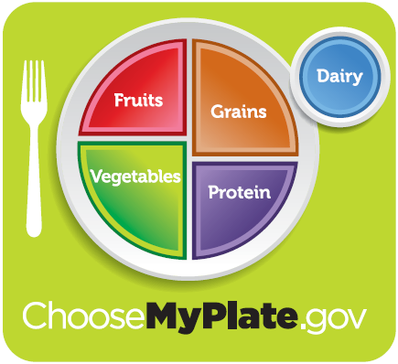
MyPlate
To help put the Dietary Guidelines into practice, you can use the MyPlate food guidance system- United States government system that helps people put the Dietary Guidelines into practice
(continued)
Courtesy of the United States Department of Agriculture

Slide 36
MyPlate
Includes the five food groups
Fruit
Fresh, frozen, canned, dried, or juiced
Grain
Vegetable
Fresh, dried, frozen, canned, cooked, or juiced
Primarily whole grains, not refined grains
Dairy
Can include calcium-fortified lactose-free alternatives
Protein food
Should eat a variety of protein foods each week
(continued)

Slide 37
MyPlate
MyPlate Daily Checklist
Provides the recommended amounts of each food for a healthy eating plan
Personalized to your age, gender, height, and weight

Slide 38
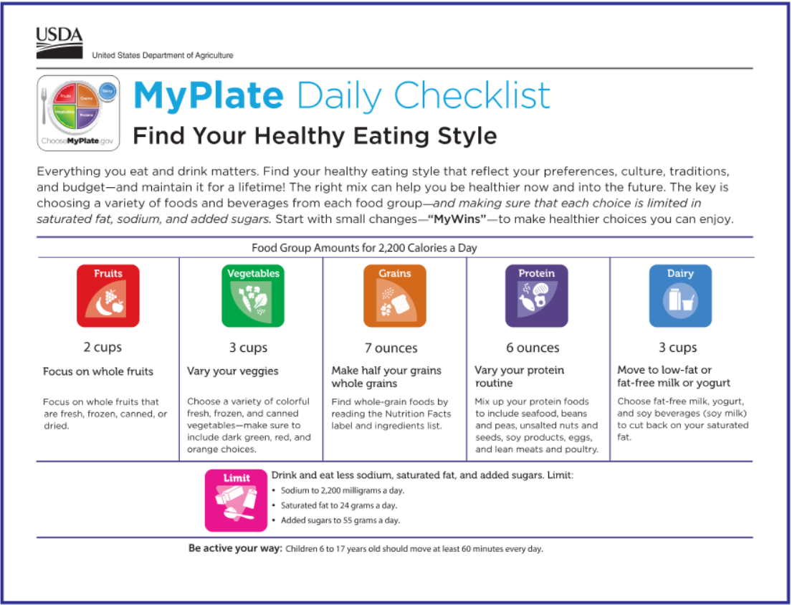

Slide 39
Poor Nutrition
Condition that results from people not receiving all the nutrients they need from the foods they eat is undernutrition
Condition that results from people eating too many foods that contain high amounts of added sugar, solid fat, sodium, refined carbohydrates, or too many calories is overnutrition

Slide 40
Think About It…
Can a person experience undernutrition and overnutrition at the same time?
Ekaterina Markelova/Shutterstock.com

Slide 41
Skills Check
Making healthy food choices
Use the MyPlate system
Choose nutrient-dense foods
Eat breakfast every day
Think about calories

Slide 42
Making Healthy Food Choices
Use nutrition information wisely
Look at the nutrition facts label to find the nutrient-density of a food
Beware of misleading health claims in food advertising
Eat healthy away from home, such as at restaurants or school

Slide 43
Calories

Slide 44
Making Healthy Food Choices -Food Label

Slide 45
Making Healthy Food Choices

Slide 46
Influences on Food Choices
Family
Help people form eating habits
Media
Commercials may persuade people to buy unhealthy foods
May be misleading about nutrition
Peers
The food choices of people’s friends can influence their own choices
Can also be positive or negative
Normal-weight children are less likely to become overweight adults

Slide 47
Influences on Food Choices

Slide 48
Skills Check
Keep food safe
Eat fresh foods before they spoil
Store jars and cans in cabinets until container is opened
Thaw frozen foods in the refrigerator
Refrigerate meat, fish, eggs, and dairy products
Cook proteins to kill bacteria

Slide 49
Lesson Review
True or false? A food high in protein and added sugars is nutrient dense.
false
What are the five MyPlate food groups?
fruits, vegetables, grains, protein, dairy
People who experience _____ take in too few nutrients for health and growth.
undernutrition

Slide 50
6.3
Managing Your Weight

Slide 51
Learning Outcomes
After studying this lesson, you will be able to
describe ways to determine healthy weight.
explain the poor health results of being underweight, overweight, or obese.
(continued)

Slide 52
Learning Outcomes
After studying this lesson, you will be able to
identify healthy weight-management strategies.
describe unhealthy weight-loss strategies.
identify healthy weight-gain strategies.

Slide 53
Weight and Body Composition
Your healthy weight range depends on
your age
your height
your gender
your body composition- Ratio of the various components-fat, bone, and muscle-that make up a person’s body
(continued)

Slide 54
Weight and Body Composition
A person who is overweight has excess body weight from fat for his or her particular age, gender, and height
Having a considerable excess of body weight from fat is called obesity
If a person has less body fat than what is considered healthy, this is underweight

Slide 55
Body Mass Index (BMI)
The body mass index (BMI) is a measure used to estimate whether a person is a healthy weight for his or her height
Each person’s BMI is a range
It is based on weight, height, age, and gender

Slide 56
Being Underweight and Your Health
Being underweight can be caused by
medical conditions
genetic makeup
Being underweight can result in
vitamin deficiencies
infections and illnesses
depression or an eating disorder
lack of access to food
fertility issues
growth and development issues

Slide 57
Being Overweight and Your Health
Being overweight or obese raises the risk of
heart disease
type 2 diabetes
sleep disorders
joint problems

Slide 58
Infographic Discussion
What can you do today to improve your healthy weight journey?

Slide 59
Skills Check
Tips for healthy weight management
Set short-term, realistic goals
By physically active
Think positively
Enlist the support of friends and family
Balance your calorie intake with physical activity
Remember that permanent change is not immediate or perfect
Talk about your goals and ask for encouragement
Reward yourself for meeting these goals

Slide 60
Calorie Balance

Slide 61
Unhealthy Weight-Loss Strategies
Weight-loss plans that forbid certain food groups are fad diets- Weight-loss plans that often forbid eating certain types of food groups and may require the purchase of special, and often costly, prepared meals
Some may suggest fasting- Not eating any food or drink except water for an entire day
Aim to lose a lot of weight in a short amount of time
Can cause undernutrition and muscle loss

Slide 62
Skills Check
Focus on eating nutrient-dense food, not simply more food
Nutrient-dense food helps the body build muscle and strengthen bones
Empty calories may add pounds, but will not benefit your health
Healthy strategies for gaining weight

Slide 63
Lesson Review
Your body composition is the ratio of fat, bone, and _____.
muscle
One of the most common health conditions associated with obesity is _____ diabetes.
type 2
(continued)

Slide 64
Lesson Review
True or false? Changing habits immediately is more likely to ensure the habits become permanent.
false
Which weight-loss strategy forbids eating certain types of foods?
fad diets

Slide 65
6.4
Treating and Preventing Body Image Issues

Slide 66
Learning Outcomes
After studying this lesson, you will be able to
compare and contrast positive and negative body image.
identify several factors that can influence a person’s body image.
(continued)

Slide 67
Learning Outcomes
After studying this lesson, you will be able to
describe the symptoms of three eating disorders.
explain approaches for treating eating disorders.

Slide 68
Body Image
A person’s thoughts
and feelings about how he or she
looks makes up your body image
May not match what your body actually looks like
A person with positive body image appreciates and values his or her body as it is
(continued)
iStock.com/ronstik

Slide 69
Body Image
Female body image
Unrealistic standards of thinness set by popular media
Male body image
Extreme measures to increase muscle size to meet unrealistic standards can include taking anabolic steroids- Artificial hormones used to treat certain types of muscular disorders that can have harmful side effects

Slide 70
Influences on Body Image
Family and peers
Family pressure for a specific body weight or shape
The media
Media messages communicate what is considered attractive
Highly edited, idealized images on social media or TV can cause body image issues
Ethnicity
Adolescents may attempt to change their bodies to meet the beauty standard for their particular ethnic group
Pressure to fit in with peers, or to attract potential dating partners

Slide 71
Eating Disorders
A serious illness that causes major disturbances in a person’s daily diet is an eating disorder
Often begin during the adolescent years
Can result in many health problems
(continued)

Slide 72
Eating Disorders

Slide 73
Eating Disorders
One eating disorder is anorexia nervosa - Eating disorder in which people have an intense fear of gaining weight and lose far more weight than is healthy
People fear gaining weight or refuse to maintain a healthy weight
They practice ongoing, severe calorie restriction
Signs include eating very little, cutting food into small portions, or eating slowly
(continued)

Slide 74
Eating Disorders
Bulimia nervosa- Eating disorder in which a person has recurrent episodes of binge eating followed by purging
Eating large quantities of food in one sitting
Followed by purging, which can include vomiting or excessive exercise
(continued)

Slide 75
Eating Disorders
The most common eating disorder is binge-eating disorder- Eating disorder characterized by people eating very large amounts of food with no control
Related to feelings of extreme distress, guilt, or depression during or after bingeing

Slide 76
Infographic Discussion
Why do you think so few adolescents seek treatment for their eating disorders?

Slide 77
Skills Check
Preventing eating disorders
Learn more
Learn all you can about eating disorders to prevent mistaken attitudes about body image
Challenge the ideal
Question the false belief that only being thin or muscular is desirable
Avoid judging based on body weight or shape
Assess your values
Value yourself on your talents and character
Do not let the way you feel about your body determine the course of your day
Avoid categorizing foods as “good” and “bad”

Slide 78
Treatment of Eating Disorders
People may not seek treatment for their eating disorders because they
are embarrassed of their behavior
believe it will go away on its own
are afraid treatment will cause them to gain weight
(continued)

Slide 79
Treatment of Eating Disorders
Eating disorders rarely go away without proper treatment
It is important for people to get help from mental health professionals
This can help prevent long-term health consequences of the disorders

Slide 80
Lesson Review
True or false? A person’s ethnicity can influence the way he or she thinks about body image.
true
Which eating disorder is associated with an intense fear of gaining weight?
anorexia nervosa

