Slide 2
3
Getting the Sleep You Need

Slide 3
3

Slide 4
Essential Question
What health benefits accompany getting enough sleep?

Slide 5
3.1
Understanding Sleep

Slide 6
Learning Outcomes
After studying this lesson, you will be able to
understand why sleep is important.
describe the sleep needs of each age group.
(continued)

Slide 7
Learning Outcomes
After studying this lesson, you will be able to
explain the science of sleep, the stages of sleep, and dreams.
determine the consequences of not getting enough sleep.

Slide 8
Benefits of Sleep
Regularly getting enough sleep
Increases productivity
Reduces chances of accidents occurring
Enhances learning
Promotes emotional well-being
Supports healthy growth and development
Helps fight common infections

Slide 9
Why Do You Need Sleep?
During sleep, the body rejuvenates itself
Sleep deprived- Term used to describe a person who gets inadequate amounts of sleep
Someone who regularly gets inadequate sleep will experience a sleep deficit- Condition that occurs when people frequently get less sleep than they should

Slide 10
How Much Sleep Do You Need?
Age Group | Sleep Needed
Newborns | 14–17 hours
Infants | 12–16 hours
Toddlers | 11–14 hours
Preschoolers | 10–13 hours
School-age children | 9–12 hours
Teenagers | 8–10 hours
Adults | 7–9 hours

Slide 11
Fact or Myth

Slide 12
Health Alert!
Some people are short sleepers-
People who can function well on less sleep than other people
This means that they can function well on less sleep than the recommended amount for their age group
Olena Yakobchuk/Shutterstock.com

Slide 13
The Science of Sleep
Circadian rhythms- Naturally occurring physical, behavioral, and mental changes in the body that typically follow the 24-hour cycle of the sun
Follows the 24-hour cycle of the sun
Regulates the sleep-wake cycle- Pattern of sleeping in a 24-hour period
Signals the release of melatonin- Hormone that increases feelings of relaxation and sleepiness and signals that it is time to go to sleep

Slide 14
The Science of Sleep

Slide 15
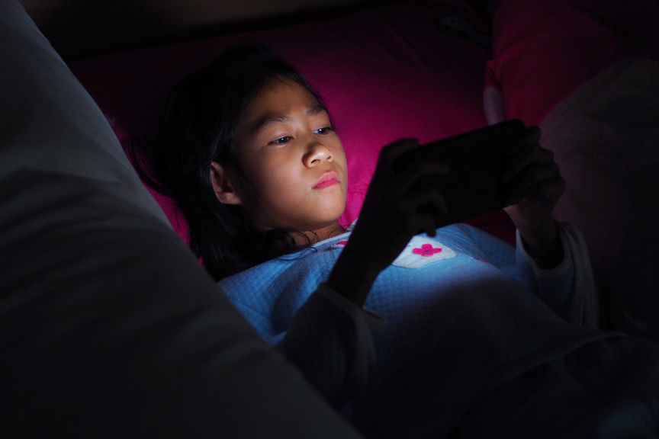
Disruptions to the Circadian Rhythm
When the body’s natural rhythm is disrupted, the body takes time to reset
This explains jet lag- Fatigue that people feel after changing time
zones when they travel
-when traveling
Can also be caused by use of electronic lights after dark
My Life Graphic/Shutterstock.com

Slide 16
Stages of Sleep

Slide 17
Stages of Sleep
There are five distinct stages of sleep
The final stage is REM sleep- Active stage of sleep during which your breathing changes, your heart rate and blood pressure rise, and your eyes dart around rapidly
A person typically cycles through all five stages of sleep every 90 to 110 minutes

Slide 18
Dreams
Most nights, people spend more than two hours dreaming
Dreams last between 5 and 20 minutes
Most dreams occur during REM sleep, but can occur during other stages
Nicole Weiss/Shutterstock.com

Slide 19
Dreams

Slide 20
The Impact of Insufficient Sleep
People who get inadequate sleep are more likely to
get colds or other infections
experience poor memory and learning
develop serious health conditions

Slide 21
Think About It…
What impact can insufficient sleep have on
an athlete?
a student?
a driver?
Kiattisak Lamchan/Shutterstock.com

Slide 22
Infographic Discussion
Why do some young people not get enough sleep at night?

Slide 23
Lesson Review
Someone who regularly gets insufficient sleep will experience a(n) _____.
sleep deficit
Newborns need _____ hours of sleep each night, while adults only need _____ hours of sleep each night.
14–17; 7–9
(continued)

Slide 24
Lesson Review
During which stage of sleep do your breathing, heart rate, and blood pressure increase?
REM sleep
True or false? The amount of sleep you get can affect your memory and problem-solving skills.
true

Slide 25
3.2
Common Sleeping Problems

Slide 26
Learning Outcomes
After studying this lesson, you will be able to
explain the symptoms of delayed sleep phase syndrome and insomnia.
describe common types of parasomnia.
(continued)

Slide 27
Learning Outcomes
After studying this lesson, you will be able to
understand the symptoms of and treatment for sleep apnea.
explain the symptoms of narcolepsy.

Slide 28
Delayed Sleep Phase Syndrome
Delayed sleep phase syndrome (DSPS) - Condition that results from a delay in the sleep-wake cycle that affects a person's daily activities
A person cannot fall asleep until very late at night and naturally wakes up later in the morning
Otherwise known as “night owl” syndrome
Most common during the teenage years

Slide 29
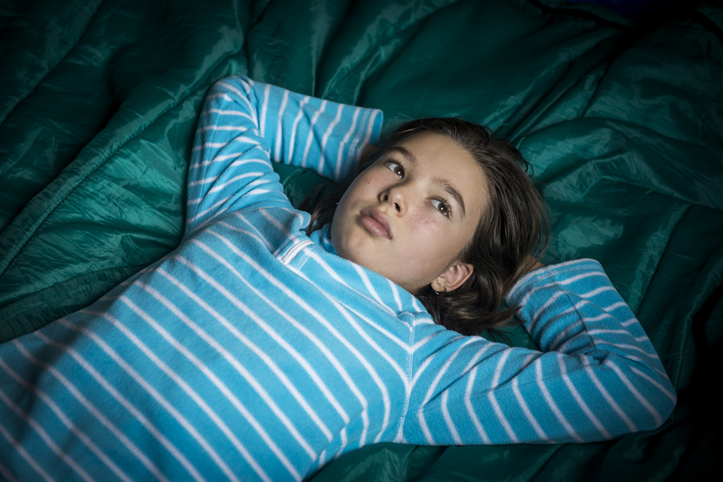
Insomnia
Insomnia- Trouble
falling or staying asleep
Can be short-term or long-term
Most commonly caused by stress
May be a symptom of a medical condition or substance abuse
Oleg Golovnev/Shutterstock.com

Slide 30
Parasomnia
Parasomnia is a term for sleep disorders that occur when people are partially, but not completely, awoken from sleep
Bed-wetting
Nightmares
Sleepwalking
Restless legs syndrome (RLS)
Teeth grinding

Slide 31
Bed-wetting and Nightmares
Bed-wetting is very common in children younger than five years of age
Drinking less liquid at night may help prevent the need to urinate while asleep
Nightmares for young people are usually about stressors in their daily lives

Slide 32
Infographic Discussion
Which emotions related to daily stressors can have an impact on nightmares?

Slide 33
Sleepwalking and Restless Leg Syndrome (RLS)
Sleepwalking can include walking slowly, running, or speaking in gibberish while asleep
People with RLS experience tingling, itching, cramping, or burning in their legs

Slide 34
Teeth Grinding
Can be caused by stress, anxiety, or misaligned teeth
Over time, can cause tooth damage, headaches, and even hearing loss
Treatments include wearing a night guard and jaw relaxation techniques
Most people occasionally grind or clench their teeth
Also known as bruxism

Slide 35
Teeth Grinding

Slide 36
Sleep Apnea
Sleep apnea- Potentially serious disorder in which a person stops breathing for short periods of time during sleep
Side effects can include
excessive daytime sleepiness
irritability
depression
increased risk of heart attack or stroke
car accidents
(continued)

Slide 37
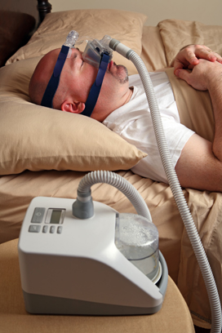
Sleep Apnea
There are two types of sleep apnea
Obstructive sleep apnea
Central sleep apnea
Can be treated with CPAP therapy
Amy Walters/Shutterstock.com

Slide 38
Sleep Apnea

Slide 39
CPAP

Slide 40
Narcolepsy
Narcolepsy- Disorder that affects the brain's ability to control the sleep-wake cycle- causes people to suddenly fall asleep for short periods of time (called sleep attacks)
This may occur when people are walking, driving, or performing other activities
Can be treated with medications and lifestyle changes

Slide 41
Lesson Review
What effect does DSPS have on a person’s sleep-wake schedule?
A person cannot fall asleep until very late at night and therefore wakes up later in the morning
_____ involves tingling or burning sensations in a person’s legs.
Restless legs syndrome (RLS)
(continued)

Slide 42
Lesson Review
The most common treatment for sleep apnea is _____ therapy.
CPAP
When a person with narcolepsy suddenly falls asleep during the day, he or she is having a(n) _____.
sleep attack

Slide 43
3.3
Developing Strategies for Getting Enough Sleep

Slide 44
Learning Outcomes
After studying this lesson, you will be able to
create a sleep schedule based on your needs.
explain the best way to take naps.
demonstrate how exercise can help you sleep better.
(continued)

Slide 45
Learning Outcomes
After studying this lesson, you will be able to
describe which substances interfere with sleep.
understand how relaxing before bedtime can help you sleep.
(continued)

Slide 46
Learning Outcomes
After studying this lesson, you will be able to
demonstrate how to create a comfortable sleep environment.
explain how to control exposure to light before bedtime.

Slide 47
Set (and Follow) a Sleep-Wake Schedule
Following a sleep-wake schedule- Routine for going to bed at about the same time each night and getting up at about the same time each morning- involves:
going to bed and waking up at about the same times every day
creating a pattern for your body to follow
A sleep-wake schedule must be followed all seven days of the week

Slide 48
Take Naps
Naps can help people catch up on sleep
Napping Strategies
Set an alarm to ensure that your nap is less than 30 minutes
Nap in the early afternoon when your body naturally wants to rest
Do not nap after dinner to avoid disrupting your sleep-wake cycle

Slide 49
Exercise Regularly
As little as 20 to 30 minutes of physical activity can help people fall and stay asleep
Try to finish the exercise at least three hours before going to sleep

Slide 50
Avoid Substances That Interfere with Sleep
Caffeine- Substance that produces a temporary increase in activity in the body, making it difficult to sleep
Tryptophan- Substance that helps the body make chemicals that help you sleep

Slide 51
Avoid Substances That Interfere with Sleep
Certain substances can either interfere with or help you sleep
Drinks or foods that contain caffeine produce a temporary increase in activity in the body
Foods that contain tryptophan can calm the brain and allow you to sleep better

Slide 52
Caffeine

Slide 53
Relax Before Bedtime
Daily stressors can cause you to not get enough sleep
Creating a bedtime routine can send a signal to your brain that it is time to sleep
Practicing relaxation techniques can also help you wind down and calm the mind

Slide 54
Skills Check
Bedtime relaxation techniques include the following:
Take slow, deep breaths
Relax all the muscles in your body
Think about being in a peaceful, calm place
Read a book or magazine
Write in a journal for a few minutes
Take a warm bath or shower
Listen to quiet music
Perform gentle stretches or meditate

Slide 55
Create a Comfortable Sleep Environment
A sleep environment should be
slightly cool, around 65°F
dark, including no electronic lights
quiet (with earplugs or a white noise machine if necessary)
Wash your sheets and pillowcases at least once a week

Slide 56
Infographic Discussion
How can using electronics in bed impact your ability to sleep well?

Slide 57
Control Exposure to Light
The hormone that makes you feel sleepy (melatonin) is affected by exposure to light
In the light, your body produces less melatonin to help you feel more alert
When it gets dark, melatonin production increases to help you fall asleep

Slide 58
Skills Check
Regulate your body’s natural response to light by
spending time outside during the day whenever possible
minimizing time spent in front of electronic devices at night
using a night-light- Small lamp, often attached directly to an electrical outlet, that provides dim light during the night- in the bathroom to avoid bright lights during the night

Slide 59
Lesson Review
Naps longer than _____ can prevent you from getting enough sleep at night.
30 minutes
How far ahead of bedtime should you finish exercising?
at least three hours
(continued)

Slide 60
Lesson Review
What is the ideal temperature for a sleeping environment?
65°F
Using a _____ in the bathroom can help you avoid bright lights in the middle of the night.
night-light

