Slide 2
2
Developing Good Personal Hygiene

Slide 3
2

Slide 4
Essential Question
Which aspects of good hygiene are important to your health?

Slide 5
2.1
Caring for Your Skin, Hair, and Nails

Slide 6
Learning Outcomes
After studying this lesson, you will be able to
describe the three distinct layers of skin.
demonstrate ways to care for the skin.
give examples of conditions that affect the skin.
(continued)

Slide 7
Learning Outcomes
After studying this lesson, you will be able to
identify strategies to keep hair healthy and looking good.
practice effective nail care.

Slide 8
The Skin
The skin is the largest organ of the human body
Protects everything inside the body (muscles, bones, other organs)
Prevents bacteria and viruses from entering the body
Plays an important role in regulating body temperature

Slide 9
The Skin

Slide 10
Layers of the Skin
There are three layers of the skin
Epidermis is the outermost layer of the skin
Dermis - Middle layer of the skin, which contains hair follicles
Hypodermis - Innermost layer of the skin, which contains fat, blood vessels, and nerve endings; attaches to underlying bone and muscle

Slide 11
Care of the Skin
Basic skin care activities
Take a bath or shower every day
Apply lotion or moisturizer to the skin
Apply deodorant or antiperspirant to prevent body odor
Eat healthy, drink enough water, and get enough sleep
Apply sun protection when spending time outside

Slide 12
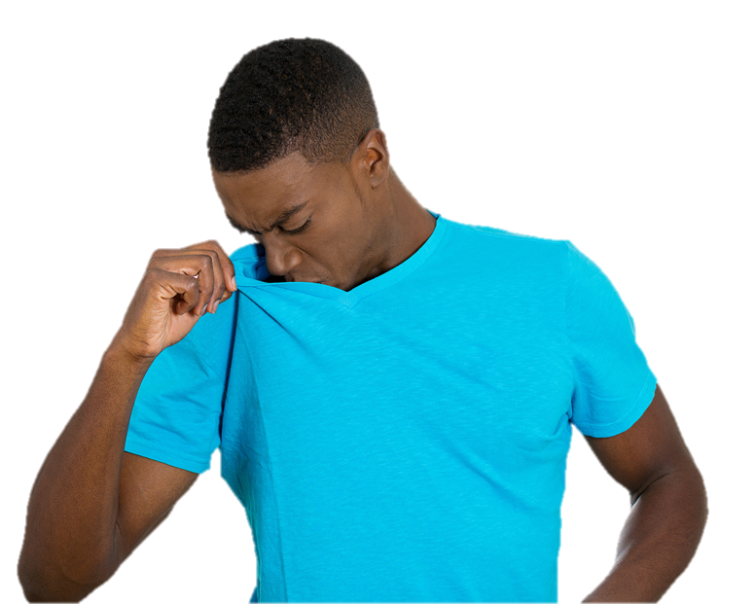
Health Alert!
A deodorant is a Product designed to cover up body odor from sweat, while an antiperspirant is a Product designed to stop or dry up sweat to prevent body odor
pathdoc/Shutterstock.com

Slide 13
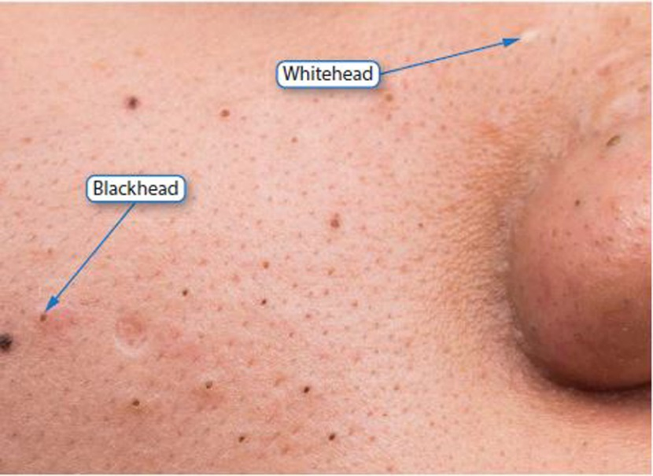
What Is Acne?
Acne - Skin condition in which inflamed, clogged hair follicles cause pimples- commonly develops during puberty
Oil glands clog pores
and cause infection
and inflammation
ThamKC/Shutterstock.com

Slide 14
Tips for Preventing and Treating Acne
Wash your face gently twice a day
Do not squeeze pimples
Avoid touching your face with your fingers
Make sure anything that touches your face is clean
Protect your skin from sunburn and suntan
Wash off any makeup before going to sleep
Shave your face lightly and not too frequently
Use over-the-counter acne medication
For serious cases of acne, consult a dermatologist

Slide 15
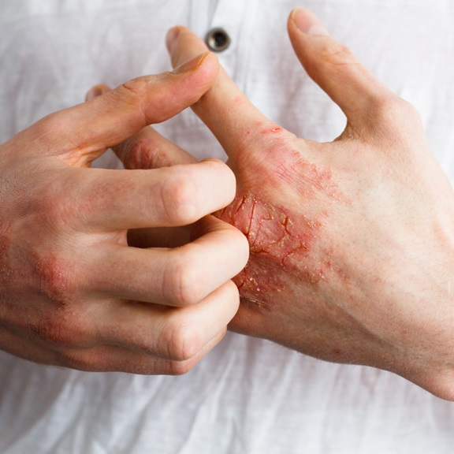
Eczema
Eczema - Chronic
condition that causes
swollen, red, dry, and itchy
patches of skin on one or more parts of the body
Is usually treated with over-the-counter products, lotion, or cream
Scratching can cause infection
Ternavskaia Olga Alibec/Shutterstock.com

Slide 16
Skin Damage from the Sun
Overexposure to the sun’s UV rays can lead to skin cancer
Suntans and sunburns are both indicators of damage to the skin
Natchapon L./Shutterstock.com

Slide 17
Skin Cancer

Slide 18
Skin Damage from the Sun

Slide 19
Infographic Discussion
What serious health condition can result from overexposure to the sun?

Slide 20
Tattoos and Piercings
Body art- Permanent decorations that are applied to the body; examples include tattoos and piercings - can potentially impact health
Dirty or unsterilized needles can cause serious infections and allergic reactions
Removal of tattoos often causes scarring

Slide 21
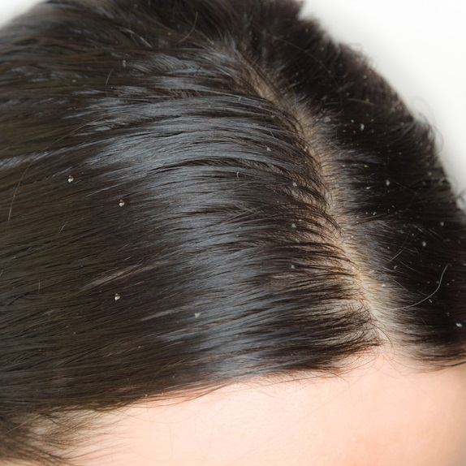
Understanding Common Hair Conditions
Many adolescents experience
greasy-looking, oily hair
Dandruff- Dead skin that
flakes off the scalp due to
dryness, infrequent shampooing, or irritation
a highly contagious hair
condition, called lice – Tiny
insects that attach to the hair
and feed on human blood
lavizzara/Shutterstock.com

Slide 22
Preventing and Treating Common Hair Conditions
Strategies to keeping your hair healthy
Eat a healthful diet to get enough vitamins and fats
Use a medicated shampoo to treat dandruff or lice
Avoid sharing items that have touched your hair with others
Wash and condition your hair regularly

Slide 23
Keeping Hair Healthy

Slide 24
Skills Check
Keep nails dry and clean to prevent growth of bacteria
Wear gloves if soaking hands (for example, when washing dishes)
Trim nails regularly with clippers or a nail file
Do not bite fingernails, pick at cuticles, or pull off hangnails
Keeping nails healthy

Slide 25
Lesson Review
What is the name of the outermost layer of the skin?
epidermis
A chronic condition that causes swollen, red, dry, and itchy patches of skin is called _____.
eczema

Slide 26
2.2
Keeping Your Mouth, Eyes, and Ears Healthy

Slide 27
Learning Outcomes
After studying this lesson, you will be able to
summarize common mouth problems people may experience.
list strategies to prevent some of the most common mouth and teeth problems.
(continued)

Slide 28
Learning Outcomes
After studying this lesson, you will be able to
identify parts of the eye and their functions.
describe common vision problems.
(continued)

Slide 29
Learning Outcomes
After studying this lesson, you will be able to
identify parts of the ear and their functions.
describe common hearing problems.

Slide 30
Oral Health
Oral health includes your mouth, teeth, and gums
Common issues include the following:
Tooth decay
Gum disease
Cold sores
Bad breath
Teeth misalignment
Teeth grinding

Slide 31
Tooth Structure

Slide 32
Tooth Decay
Plaque - Sticky, colorless film that coats the teeth and dissolves their protective enamel surface
If not removed by brushing and flossing, plaque can become tartar, a harder substance that must be removed professionally
(continued)

Slide 33
Plaque

Slide 34
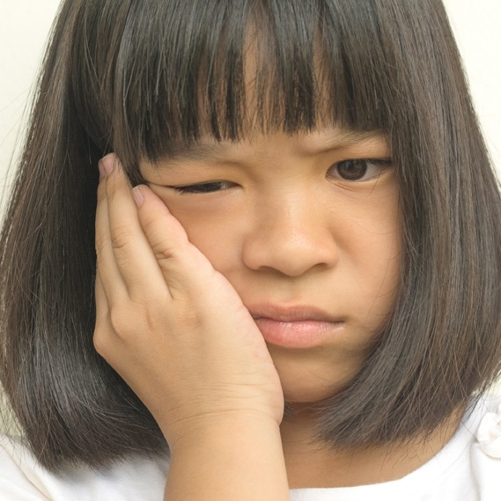
Tooth Decay
A lack of brushing and flossing can cause
Cavities - Holes in the teeth
that occur when plaque eats
into a tooth's enamel
deeper nerve damage
BlurryMe/Shutterstock.com

Slide 35
Gum Disease
Gum disease can develop when plaque and tartar build up on the teeth
Irritation can lead to gingivitis-inflammation of the gums
Periodontitis - Infection caused by bacteria getting under the gum tissue and destroying the gums and bone

Slide 36
Common Mouth and Teeth Problems
Teeth misalignment
Impacted wisdom teeth
Cold sores on lips or inside mouth
Bad breath
Teeth grinding
Other common problems include

Slide 37
Preventing and Treating Mouth and Teeth Problems
Some problems require professional treatment
A dentist can fill cavities
An orthodontist - Dental specialist who prevents and corrects teeth misalignments

Slide 38
Skills Check
Other mouth and teeth problems can be treated by
brushing and flossing twice a day
avoiding any type of tobacco
limiting sticky or sugary foods and drinks
using an antiseptic mouth-rinse
wearing a mouth guard during activities that can result in broken teeth
using ointment to treat cold sores

Slide 39
The Parts of the Eye
BlueRingMedia/Shutterstock.com

Slide 40
Common Vision Problems
Nearsightedness - Condition in which objects close to the eye appear clear, while objects farther away appear blurry
Farsightedness - Condition in which distant objects are seen more clearly than nearby objects
(continued)

Slide 41
Common Vision Problems
Astigmatism - Condition in which the eye does not focus light evenly onto the retina; objects appear blurry and stretched out
Presbyopia - Condition beginning in middle age in which the lens of the eye loses its elasticity and it becomes harder to see close objects clearly
(continued)

Slide 42
Red-Green Color Blind Test

Slide 43
Common Vision Problems

Slide 44
Common Vision Problems
These vision problems can usually be corrected with glasses or contact lenses
Certain surgeries like LASIK can also correct or improve some vision problems

Slide 45
Skills Check
Keeping your eyes healthy
Wear protective eyewear during contact sports or activities with debris
Wear sunglasses when spending time outdoors
If you wear contact lenses, care for them properly
Get regular eye exams for preventive care

Slide 46
Parts of the Ear
The ear has three main parts
The outer ear brings sound in and amplifies it in the auditory canal
The inner ear converts vibrations into impulses that the brain recognizes as sound
The middle ear (including the eardrum) vibrates when sounds reach it

Slide 47
Parts of the Ear

Slide 48
Common Hearing Problems
Hearing loss is typically caused by damage to the inner ear
Usually the result of repeated exposure to loud sounds (at or above 85 decibels)
One early sign of damage is tinnitus - Pain or ringing in the ears after exposure to excessively loud sounds

Slide 49
Health Alert!
The louder the sound, the less time it takes for hearing damage to occur.
A single sound blast at or above 120 decibels can cause hearing loss.
dwphotos/Shutterstock.com

Slide 50
Think About It…
Name a source of loud noise to which you are frequently exposed.
What are some ways you can protect yourself from hearing loss?

Slide 51
Lesson Review
If plaque buildup irritates the gums, an inflammation called _____ can form.
gingivitis
Which vision problem involves when distant objects are more blurry than nearby objects?
nearsightedness
(continued)

Slide 52
Lesson Review
At what decibel does hearing damage begin to occur?
85
An early sign of hearing damage, pain or ringing in the ears, is called _____.
tinnitus

